Slide 1
Ancient Greece
Chapter 5

Slide 2
SCULPTURE

Slide 3
GEOMETRIC

Slide 4
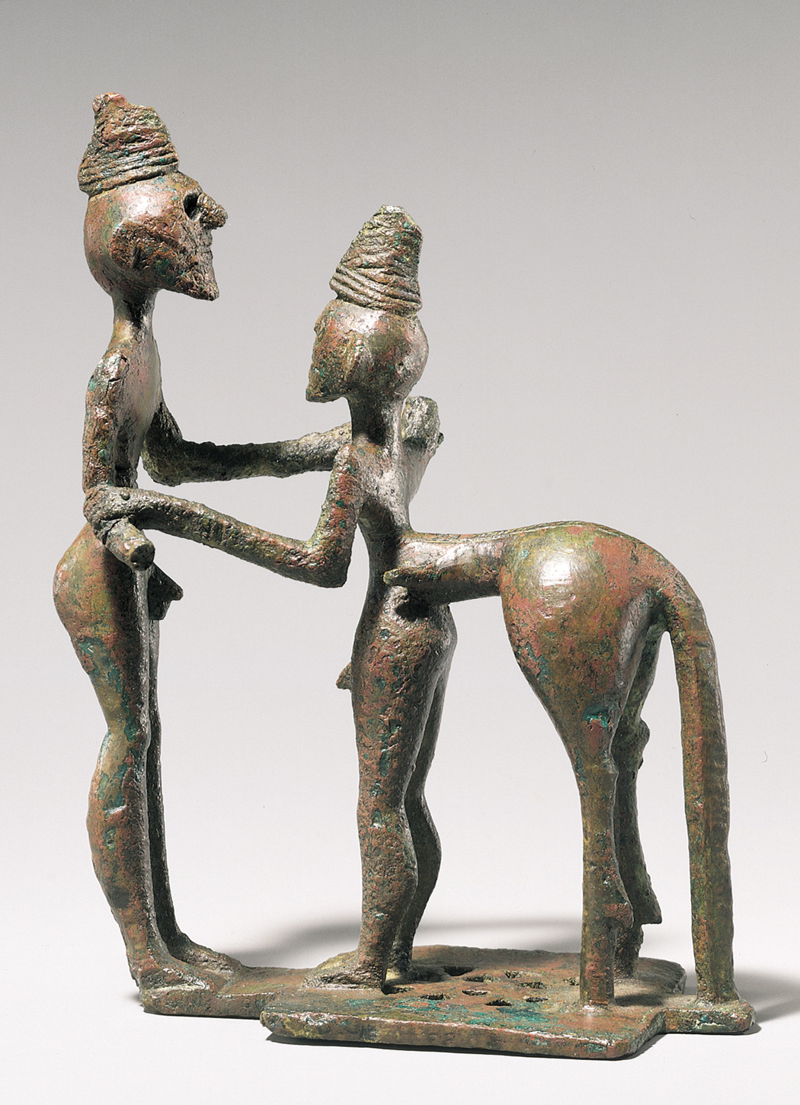
Figure 5-3 Hero and centaur (Herakles and Nessos?), from Olympia,Greece, ca. 750–730 BCE. Bronze, 4 1/2” high. Metropolitan Museum of Art, New York (gift of J. Pierpont).

Slide 5
ORIENTALIZING

Slide 6
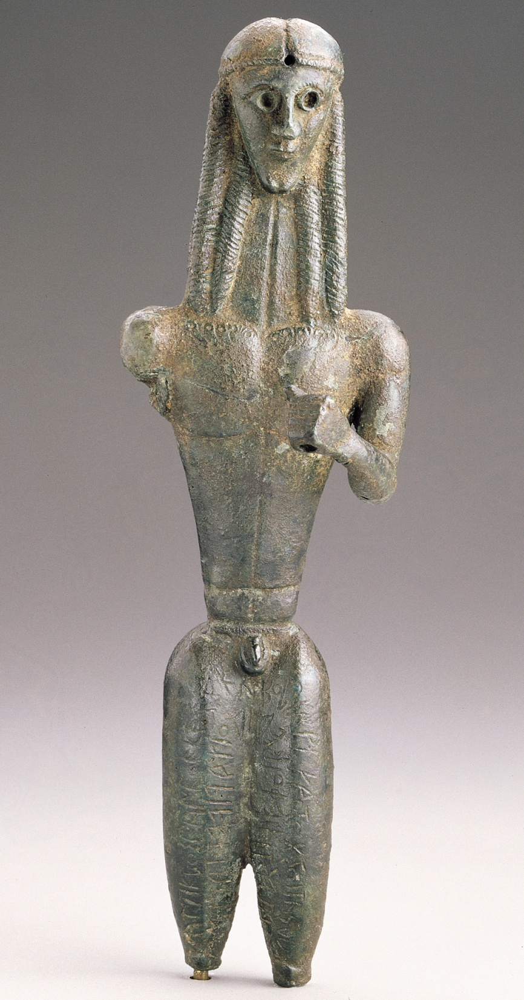
Figure 5-4 Mantiklos Apollo, statuette of a youth dedicated by Mantiklos to Apollo, from Thebes, Greece, ca. 700–680 BCE. Bronze, 8” high. Museum of Fine Arts, Boston.

Slide 7
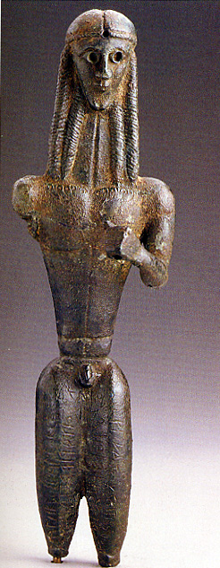
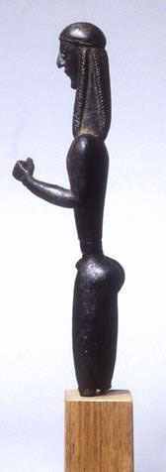
Mantiklos Apollo

Slide 8
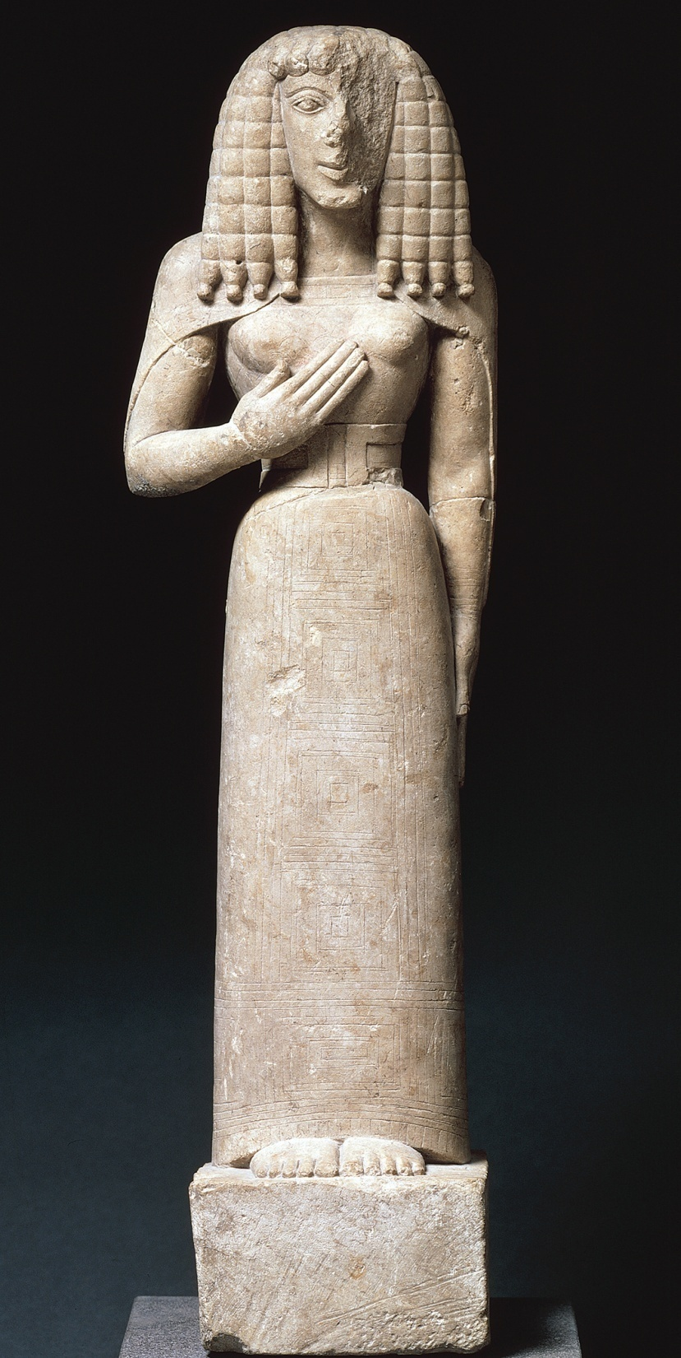
Figure 5-6 Lady of Auxerre, ca. 650–625 BCE. Limestone, 2’ 1 1/2” high. Louvre, Paris.

Slide 9
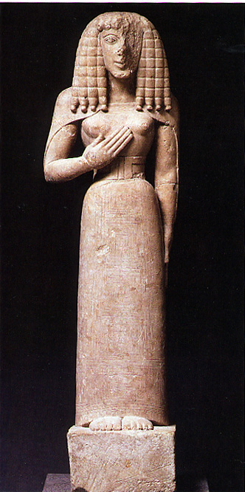
Gardner’s Art Through the Ages
www.marquette.edu

Slide 10
ARCHAIC PERIOD

Slide 11
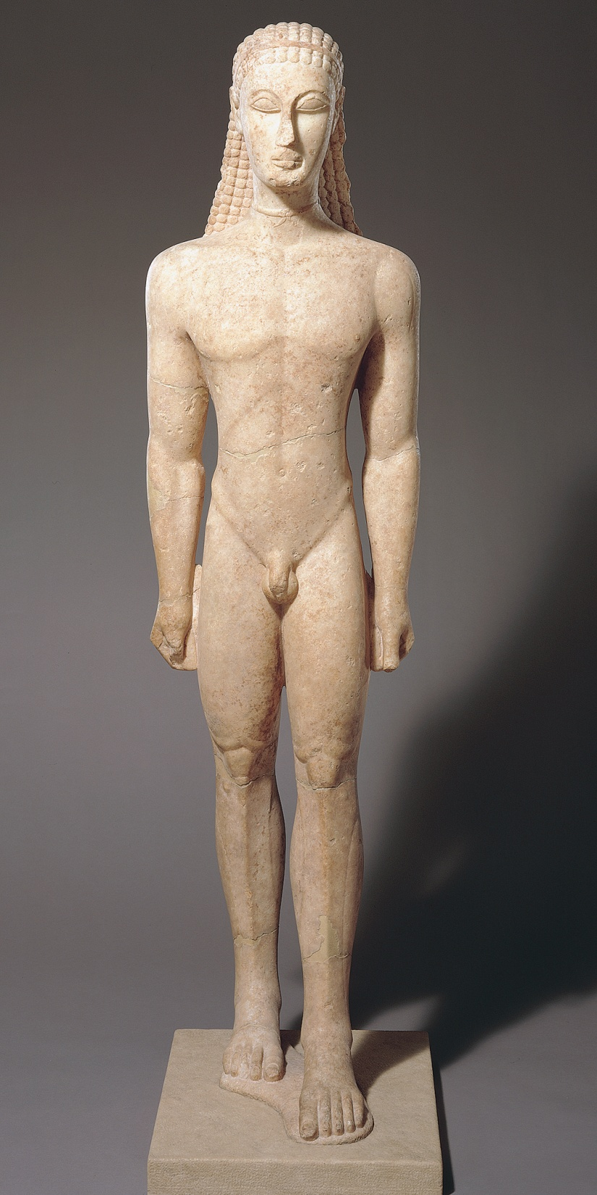
Figure 5-7 Kouros, ca. 600 BCE. Marble, 6’ 1/2” high. Metropolitan Museum of Art, New York.

Slide 12
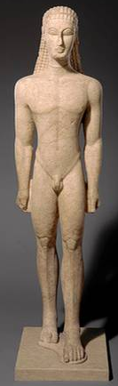
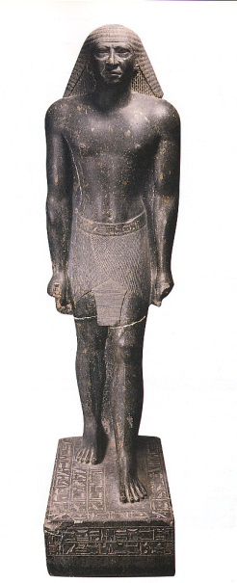
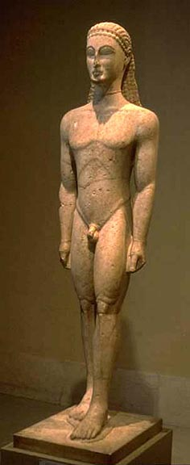
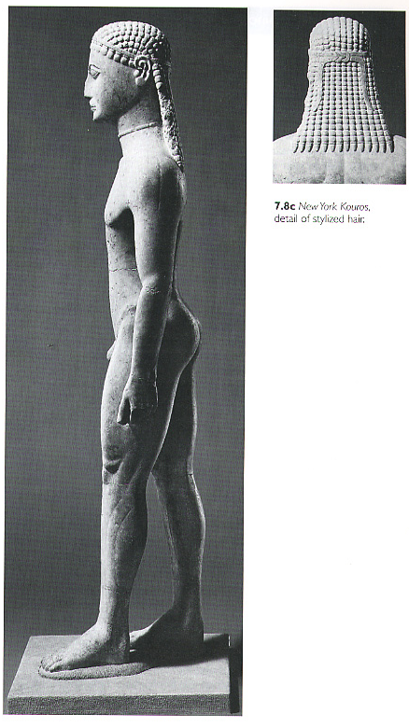
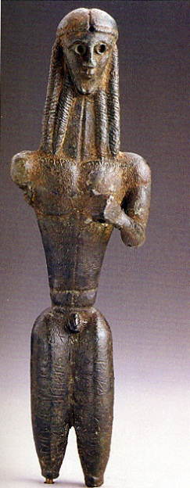
Compare with:
Kouros

Slide 13
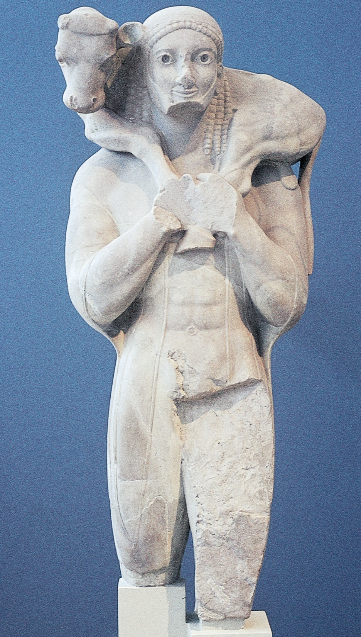
Figure 5-8 Calf Bearer, dedicated by Rhonbos on the Acropolis, Athens, Greece, ca. 560 BCE. Marble, restored height 5’ 5”; fragment 3’ 11 1/2” high. Acropolis Museum, Athens.

Slide 14
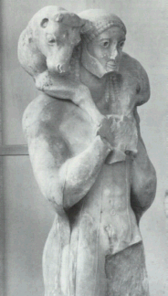
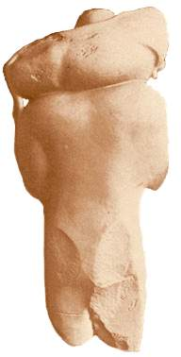
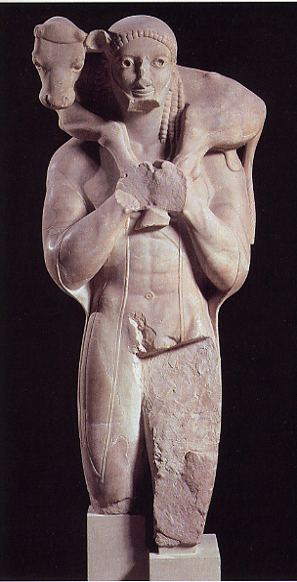
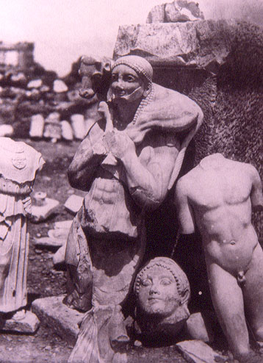
Gardner’s 12th ed, p. 113

Slide 15
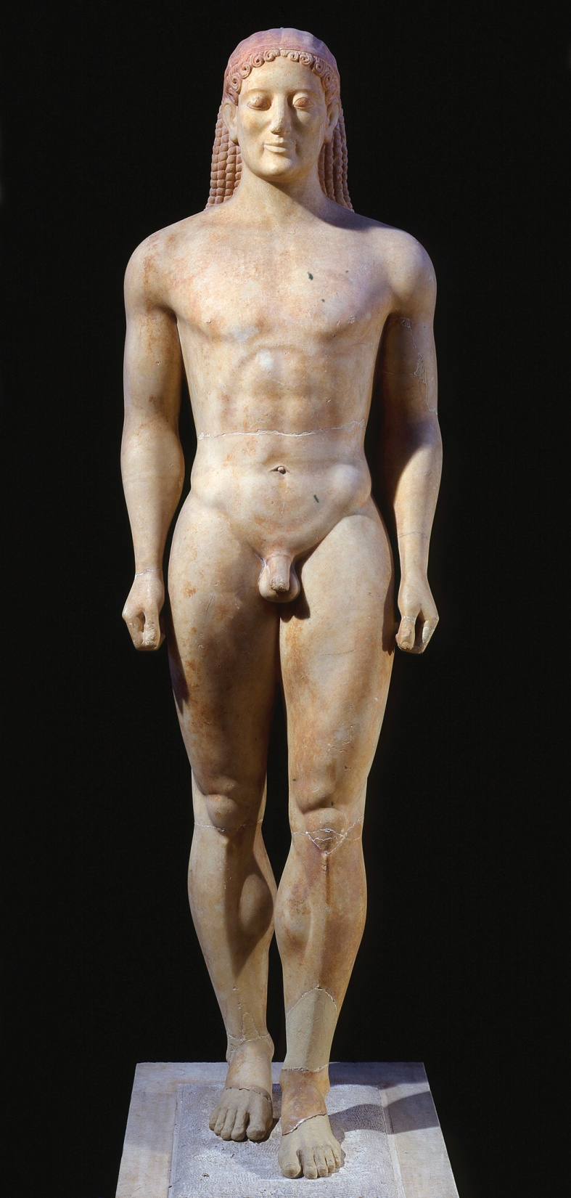
Figure 5-9 Kroisos, from Anavysos, Greece, ca. 530 BCE. Marble, 6’ 4” high. National Archaeological Museum, Athens.
Why did Greek artists render the male form in the nude?

Slide 16
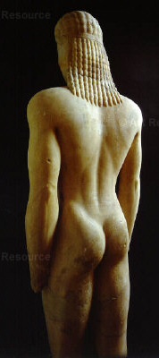
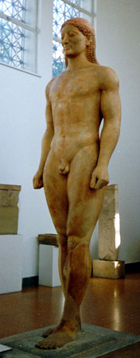
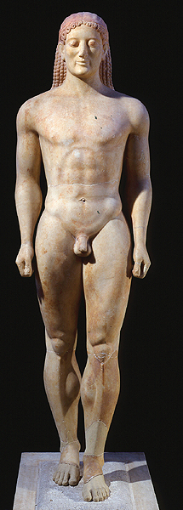
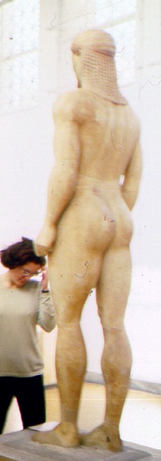
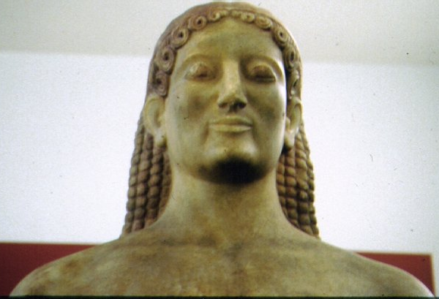

Slide 17
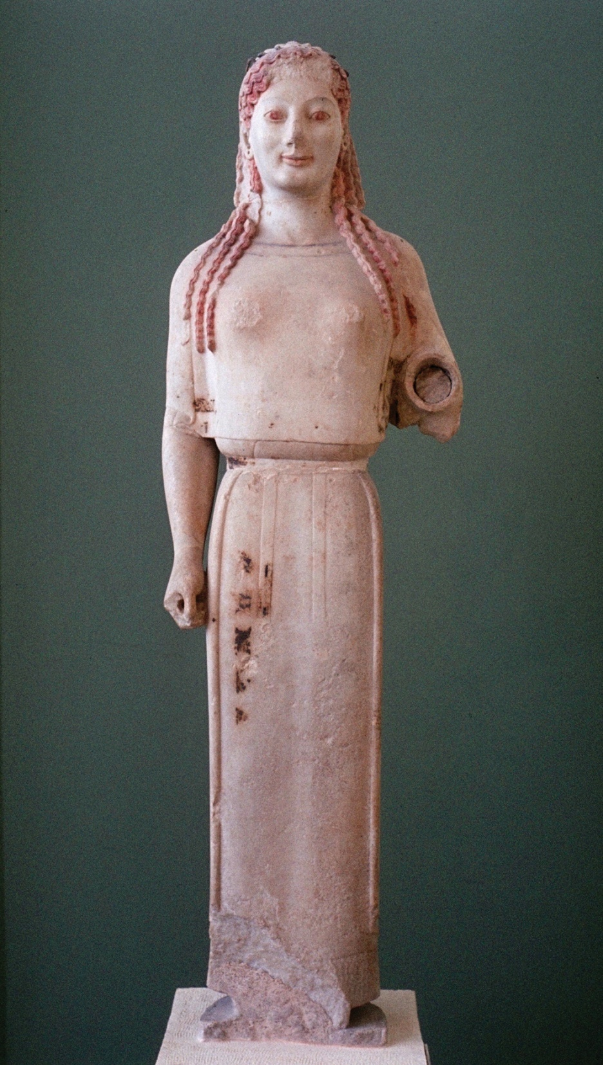
Figure 5-10 Peplos Kore, from the Acropolis, Athens, Greece, ca. 530 BCE. Marble, 4’ high. Acropolis Museum, Athens.
Notice traces of encaustic paint on the Peplos Kore. Most Greek stone statues were painted.
Notice also that the Peplos Kore is clothed.

Slide 18
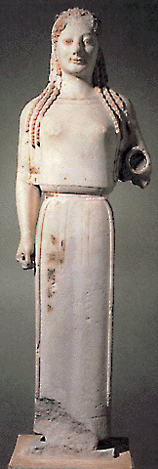
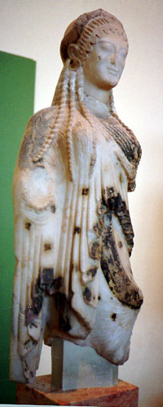
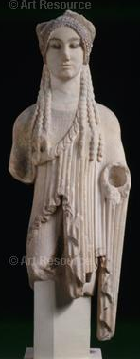
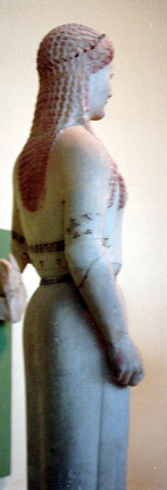
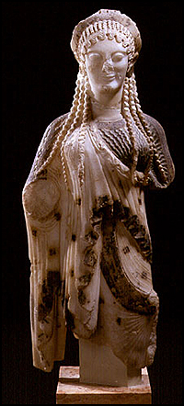
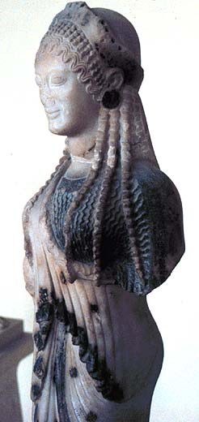
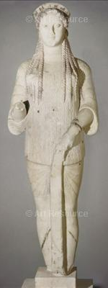
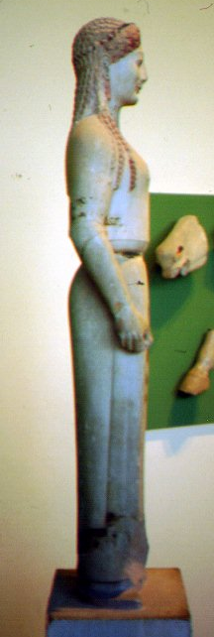
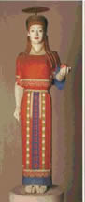
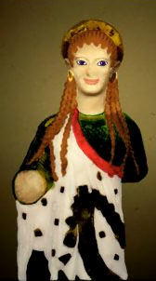

Slide 19
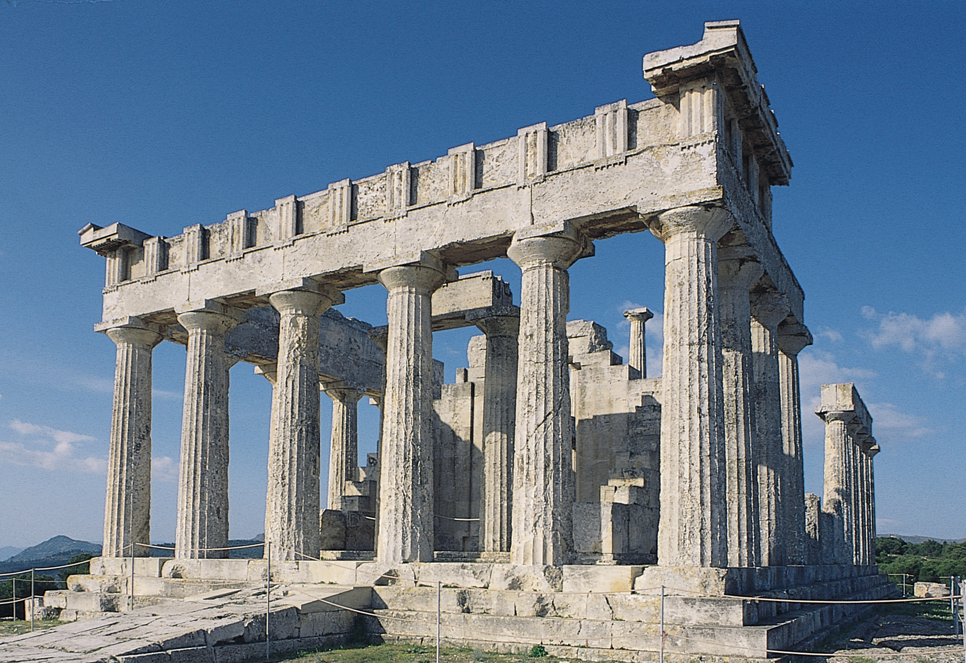
Figure 5-24 Temple of Aphaia, Aegina, Greece, ca. 500–490 BCE.

Slide 20
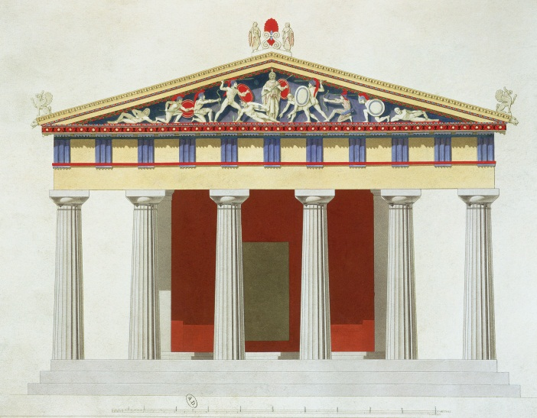
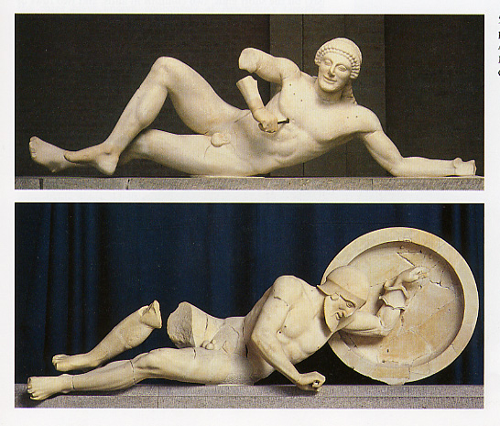
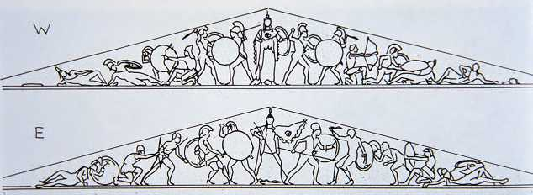
Dying Warrior from east pediment

Slide 21
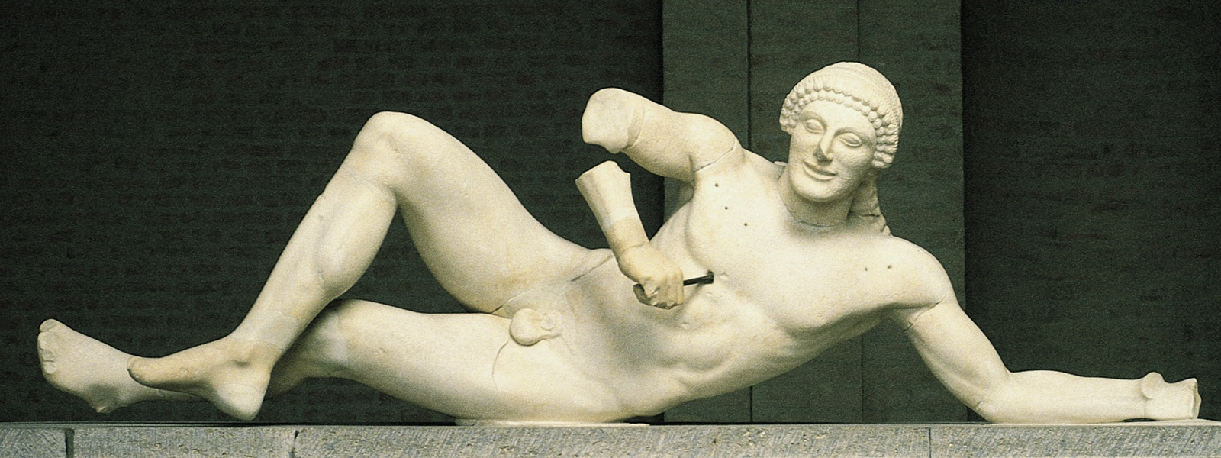
Figure 5-27 Dying warrior, from the west pediment of the Temple of Aphaia, Aegina, Greece, ca. 500–490 BCE. Marble, 5’ 2 1/2” long. Glyptothek, Munich.

Slide 22
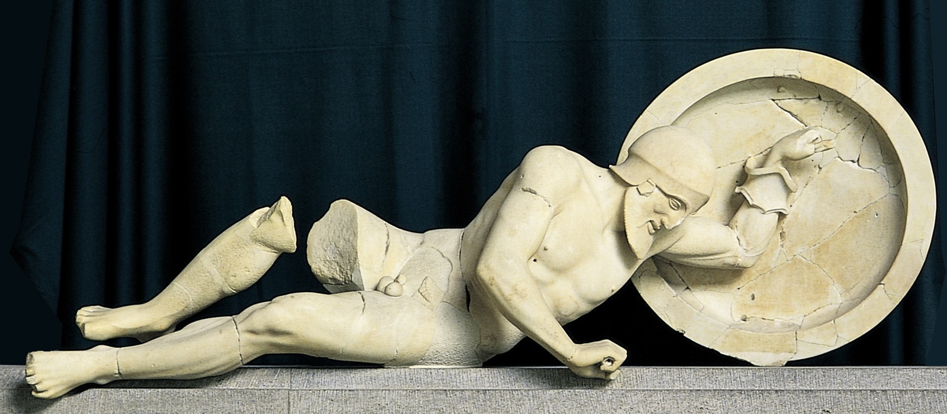
Figure5-28 Dying warrior, from the east pediment of the Temple of Aphaia, Aegina, Greece, ca. 480 BCE. Marble, 6’ 1” long. Glyptothek, Munich.

Slide 23
EARLY CLASSICAL

Slide 24
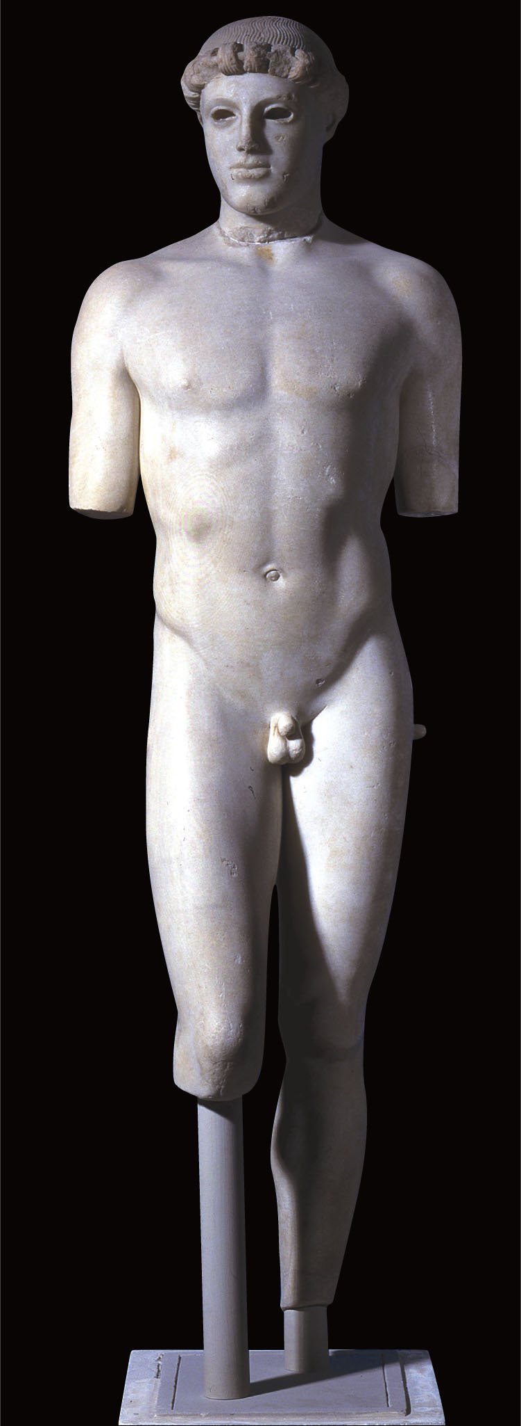
Figure 5-34 Kritios Boy, from the Acropolis, Athens, Greece, ca. 480 BCE. Marble, 2’ 10” high. Acropolis Museum, Athens.
Kritios Boy is the earliest known example of contrapposto, a relaxed and natural stance.
Notice how his weight shifts to his left leg and how his head turns slightly to his right.
Notice absence of Archaic smile

Slide 25
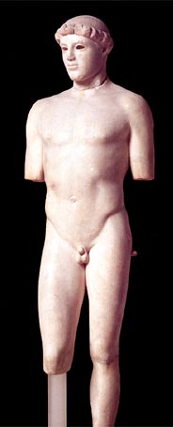
Kritios Boy

Slide 26
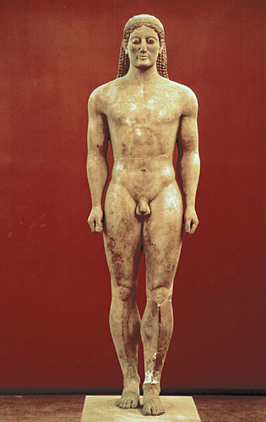
CONTRAPPOSTO
If we look at the early Greek sculpture, the Anavysos Kouros (c 525 BCE), the unnatural stiffness is still present.
...the shoulders are level
...the hips are level
...both fists are level
...even the knees are level
...but the left leg is thrust forward. The left leg is forward and would have to be six inches longer!
Does the Anavysos Koursos statue demonstrate contrapposto?
The Answer is NO.

Slide 27
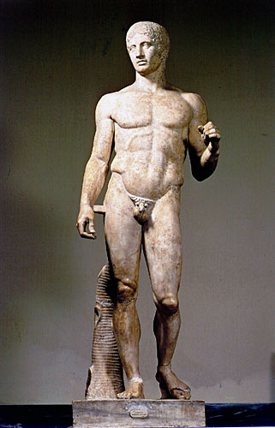
CONTRAPPOSTO
Contrapposto first appeared in classical Greek sculpture.
...the left shoulder is higher than the right shoulder
...an angle from the right shoulder to the left hip. The leg is relaxed and the hip bone is lower.
...the right leg bears all the body’s weight.
Also notice how the knees are not level and at an angle. The shoulders counterbalance the hips.
If the hips and shoulders were parallel, we could not balance and would fall over!

Slide 28
CONTRAPPOSTO
The classical Greeks progressed to where they were able to model the human in a nonsymmetrical, relaxed stance that appears much more realistic. This was lost during the Middle Ages and was rediscovered by artists like Donatello during the Renaissance

Slide 29
5-37 Charioteer, from a group dedicated by Polyzalos pf Gela in the sanctuary of Apollo, Delphi, Greece, ca. 470 BCE. Bronze, 5’ 11” high. Archeological Museum, Delphi.

Slide 30
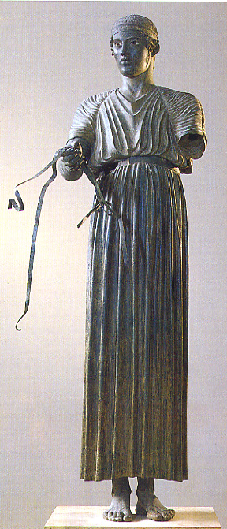
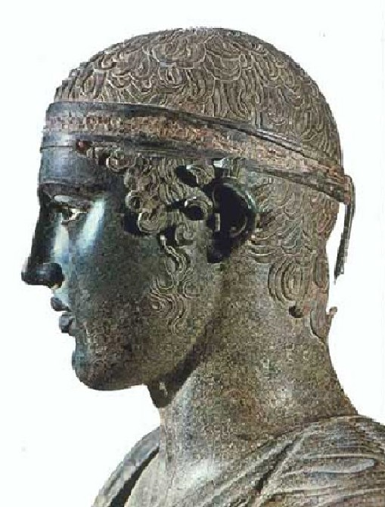
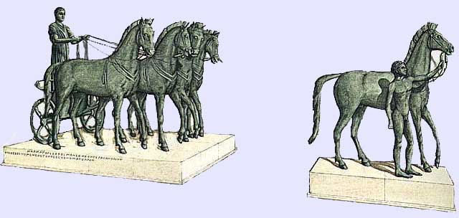
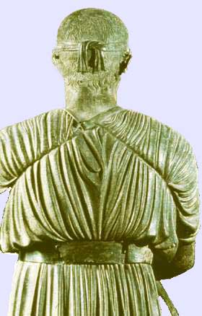
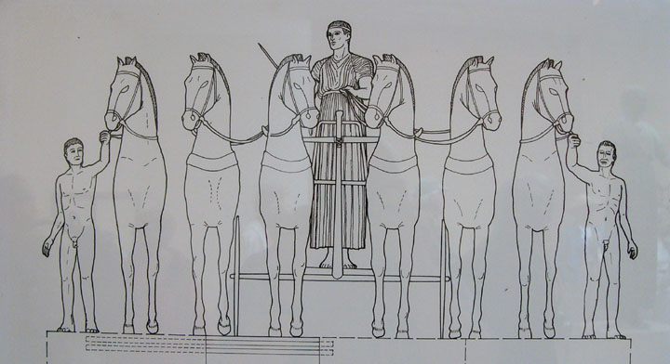

Slide 31
5-36 Two stages of the lost-wax method of bronze casting (after Sean A. Hemmingway).

Slide 32
HIGH CLASSICAL

Slide 33
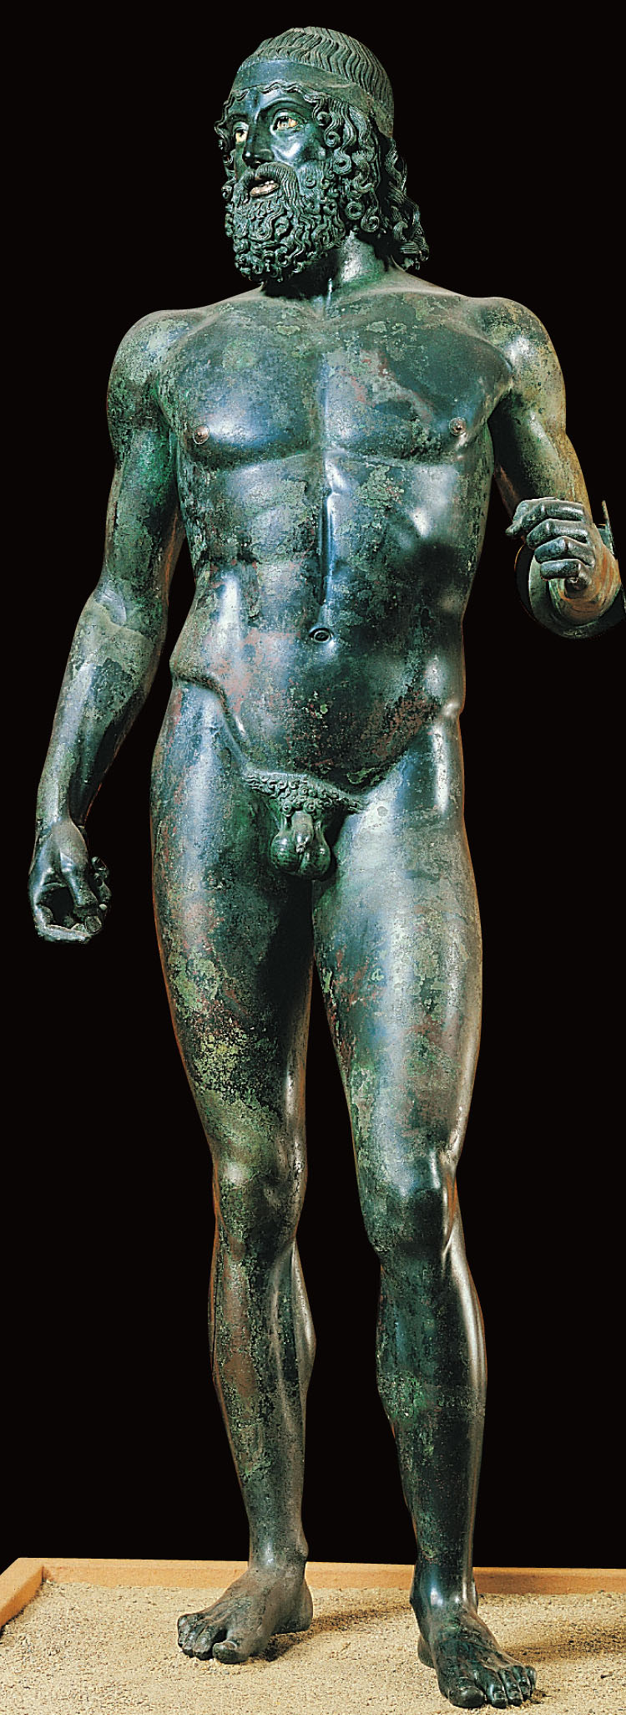
Figure 5-35 Warrior, from the sea off Riace, Italy, ca. 460–450 BCE. Bronze, 6’ 6” high. Museo Archeologico Nazionale, Reggio Calabria.
This Riace Warrior, like most Classical Greek statues, was sculpted in bronze. Most Classical bronzes have not survived.
Much of the Classical Greek sculptures today are Roman marble copies.

Slide 35
Fig. 5-38 Zeus (or Poseidon?), from the sea off Cape Artemision, Greece, ca. 460–450 BCE. Bronze, 6’ 10” high. National Archaeological Museum, Athens.

Slide 37
Figure 5-39 MYRON, Diskobolos (Discus Thrower). Roman marble copy of a bronze original of ca. 450 BCE, 5’ 1” high. Museo Nazionale Romano—Palazzo Massimo alle Terme.

Slide 39
Figure 5-40 POLYKLEITOS, Doryphoros (Spear Bearer). Roman marble copy from Pompeii, Italy, after a bronze original of ca. 450–440 BCE, 6’ 11” high. Museo Archeologico Nazionale, Naples.
Doryphoros (Spear Thrower), POLYKEITOS
Originally titled Canon
Established Polykleitos’ canon of proportions, setting ideal correlations among body parts
Contrapposto
Notice the harmony of opposites

Slide 41
Chiastic (cross balance)
Chiastic (cross balance) is asymmetrical balance
…right arm and leg rigid & stiff creating columnar stability and anchoring
…the bent left arm and leg
…head turns right, hips twist left, back foot turns outward creating a twist in the body

Slide 42
Figure 5-42 Aerial view of the Acropolis looking southeast, Athens, Greece.

Slide 44
Figure 5-1 IKTINOS and KALLIKRATES, Parthenon, (Temple of Athena Parthenos, looking southeast), Acropolis, Athens, Greece, 447–438 BCE.

Slide 45
Figure 5-46 PHIDIAS, Athena Parthenos, in the cella of the Parthenon, Acropolis, Athens, Greece, ca. 438 BCE. Model of the lost chryselephantine statue. Royal Ontario Museum, Toronto.

Slide 46
5-47 Lapith versus centaur, metope from the south side of the Parthenon, Acropolis, Athens, Greece, ca. 447-438 BCE. Marble, 4’ 8” high. British Museum, London.

Slide 48
Figure 5-48 Helios and his horses, and Dionysos (Herakles?), from the east pediment of the Parthenon, Acropolis, Athens, Greece, ca. 438–432 BCE. Marble, greatest height 4’ 3”. British Museum, London.

Slide 49
Figure 5-49 Three goddesses (Hestia, Dione, and Aphrodite?), from the east pediment of the Parthenon, Acropolis, Athens, Greece, ca. 438–432 BCE. Marble, greatest height 4’ 5”. British Museum, London.

Slide 50
Helios and his horses, and Dionysis
Three Goddess (Hestia, Dione, and Aphrodite?)
1. Helios | 4. Nike | 7. Hera | 10. Atlas
2. Herakles | 5. Athena | 8. Hephaistos | 11. The Hesperides
3. The Fates | 6. Zeus | 9. Hermes | 12. Nyx

Slide 51
Figure 5-51 MNESIKLES, Propylaia (looking southwest), Acropolis, Athens, Greece, 437–432 BCE.

Slide 52
Erechtheion and Plan

Slide 53
Figure 5-54 Caryatids of the south porch of the Erechtheion, Acropolis, Athens, Greece, ca. 421–405 BCE. Marble, 7’ 7” high.

Slide 54
Caryatid from south porch of Erechtheion

Slide 55
Figure 5-56 Nike adjusting her sandal, from the south side of the parapet of the Temple of Athena Nike, Acropolis, Athens, Greece, ca. 410 BCE. Marble, 3’ 6” high. Acropolis Museum, Athens.

Slide 56
KALLIKRATES,
Temple of Athena Nike
Nike adjusting her sandal
dl.ccc.cccd.edu/.../art100/imageindex.htm

Slide 57
Late Classical

Slide 58
Figure 5-62 PRAXITELES, Aphrodite of Knidos. Roman marble copy of an original of ca. 350–340 BCE. 6’ 8” high. Musei Vaticani, Rome.
Aphodite of Knidos, PRAXITELES
Bold step to render a goddess in the nude
Sensuous and humanizing qualities – different from the cold, aloof gods and athletes of the High Classical

Slide 59
Aphrodite of Knidos

Slide 60
Figure 5-63 PRAXITELES(?), Hermes and the infant Dionysos, from the Temple of Hera, Olympia, Greece. Copy of a statue by Praxiteles of ca. 340 BCE or an original work of ca. 330–270 BCE by a son or grandson. Marble, 7’ 1” high. Archaeological Museum, Olympia
Hermes and the infant Dionysus
By follower of Praxiteles (son or grandson possibly)
Notice S-curve of the body (pronounced contrapposto)
New standard of adult and child interaction

Slide 61
Hermes and the infant Dionysos

Slide 62
Figure 5-65 LYSIPPOS, Apoxyomenos (Scraper). Roman marble copy of a bronze original of ca. 330 BCE, 6’ 9” high. Musei Vaticani, Rome.
Apoxyomenos, LYSIPPOS
Established a different canon of proportions from that of Polykleitos

Slide 64
Figure 5-66 LYSIPPOS, Weary Herakles (Farnese Herakles). Roman marble copy from Rome, Italy, signed by GLYKON OF ATHENS, of a bronze original of ca. 320 BCE. 10 ‘ 5” high. Museo Archeologico Nazionale,Naples.

Slide 65
Farnese Herakles

Slide 66
Hellenistic

Slide 67
Figure 5-81 EPIGONOS(?), Dying Gaul. Roman marble copy of a bronze original of ca. 230–220 BCE, 3’ 1/2” high. Museo Capitolino, Rome.

Slide 69
Figure 5-82 Nike alighting on a warship (Nike of Samothrace), from Samothrace, Greece, ca. 190 BCE. Marble, figure 8’ 1” high. Louvre, Paris.

Slide 71
Figure 5-84 Sleeping satyr (Barberini Faun), from Rome, Italy, ca. 230–200 BCE. Marble, 7’ 1” high. Glyptothek, Munich.

Slide 72
Figure 5-83 ALEXANDROS OF ANTIOCH-ON-THE-MEANDER, Aphrodite (Venus de Milo), from Melos, Greece, ca. 150–125 BCE. Marble, 6’ 7” high. Louvre, Paris.

Slide 73
Figure 5-86 Seated boxer, from Rome, Italy, ca. 100–50 BCE. Bronze, 4’ 2” high. Museo Nazionale Romano–Palazzo Massimo alle Terme, Rome.

Slide 74
Seated boxer

Slide 75
Figure 5-87 Old market woman, ca. 150–100 BCE. Marble, 4’ 1/2” high. Metropolitan Museum of Art, New York.

Slide 76
Old market woman

Slide 77
Figure 5-89 ATHANADOROS, HAGESANDROS, and POLYDOROS OF RHODES, Laocoön and his sons, from Rome, Italy, early first century CE Marble, 7’ 10 1/2” high. Musei Vaticani, Rome.

Slide 78
Laocoon and his sons

Slide 79
ARCHITECTURE

Slide 80
ARCHAIC

Slide 81
Figure 5-12 Plan of a typical peripteral Greek temple.
Peripteral Greek Temple

Slide 82
Figure 5-13 Elevations of the Doric and Ionic orders.
Compare Doric and Ionic Orders

Slide 83
Capitals & Orders
Doric
Corinthian Ionic

Slide 84
Figure 5-14 Temple of Hera I (“Basilica”), Paestum, Italy, ca. 550 BCE.

Slide 85
Figure 5-15 Plan of the Temple of Hera I, Paestum, Italy, ca. 550 BCE.

Slide 86
Temple of
Hera I
Peripteral (single) colonnade
Antis
Plan of theTemple of Hera I
Gardner’s 11th ed
Stokstad, p. 162

Slide 87
Figure 5-16 West pediment from the Temple of Artemis, Corfu, Greece, ca. 600–580 BCE. Limestone, greatest height 9’ 4”. Archaeological Museum, Corfu.

Slide 88
West Pediment, Temple of Artemis
Possible painted colors

Slide 90
Figure 5-24 Temple of Aphaia, Aegina, Greece, ca. 500–490 BCE.

Slide 91
5-25 Model of the Temple of Aphaia, Aegina, Greece, ca. 500-490 BCE, showing internal elevation. Glyptothek, Munich.

Slide 92
Figure5-26 GUILLAUME-ABEL BLOUET’S 1828 restored view of the façad of the Temple of Aphaia, Aegina, Greece, ca. 500–490 BCE.

Slide 93
Temple of Aphaia & Plan
Gardner’s 11th ed

Slide 94
Figure 5-27 Dying warrior, from the west pediment of the Temple of Aphaia, Aegina, Greece, ca. 500–490 BCE. Marble, 5’ 2 1/2” long. Glyptothek, Munich.

Slide 95
Figure5-28 Dying warrior, from the east pediment of the Temple of Aphaia, Aegina, Greece, ca. 480 BCE. Marble, 6’ 1” long. Glyptothek, Munich.

Slide 96
EARLY CLASSICAL

Slide 97
Figure 5-29 Temple of Hera II, Paestum, Italy, ca. 460 BCE.

Slide 98
Gardner’s 12th ed., p. 127
Gardner’s 12th ed
Temple of Hera II

Slide 99
HIGH CLASSICAL

Slide 100
Figure 5-42 Aerial view of the Acropolis looking southeast, Athens, Greece.

Slide 101
IKTINOS and KALLIKRATES, Parthenon

Slide 102
5-43 Restored view of the Acropolis, Athens, Greece (John Burge). (1) Parthenon, (2) Propylaia, (3) pinakotheke, (4) Erechtheion, (5) Temple of Athena Nike.

Slide 103
Figure 5-1 IKTINOS and KALLIKRATES, Parthenon, (Temple of Athena Parthenos, looking southeast), Acropolis, Athens, Greece, 447–438 BCE.

Slide 104
Figure 5-45 Plan of the Parthenon, Acropolis, Athens, Greece, with diagram of sculptural program (after Andrew Stewart), 447–432 BCE.

Slide 105
Figure 5-46 PHIDIAS, Athena Parthenos, in the cella of the Parthenon, Acropolis, Athens, Greece, ca. 438 BCE. Model of the lost chryselephantine statue. Royal Ontario Museum, Toronto.

Slide 106
5-47 Lapith versus centaur, metope from the south side of the Parthenon, Acropolis, Athens, Greece, ca. 447-438 BCE. Marble, 4’ 8” high. British Museum, London.

Slide 107
Figure 5-48 Helios and his horses, and Dionysos (Herakles?), from the east pediment of the Parthenon, Acropolis, Athens, Greece, ca. 438–432 BCE. Marble, greatest height 4’ 3”. British Museum, London.

Slide 108
Figure 5-49 Three goddesses (Hestia, Dione, and Aphrodite?), from the east pediment of the Parthenon, Acropolis, Athens, Greece, ca. 438–432 BCE. Marble, greatest height 4’ 5”. British Museum, London.

Slide 109
Figure 5-50 Details of the Panathenaic Festival procession frieze, from the Parthenon, Acropolis, Athens, Greece, ca. 447–438 BCE. Marble, 3’ 6” high. Horsemen of north frieze (top), British Museum, London; seated gods and goddesses (Poseidon, Apollo, and Artemis) of east frieze (center), Acropolis Museum, Athens; and elders and maidens of east frieze (bottom), Louvre, Paris.

Slide 110
Figure 5-52 Erechtheion (looking northwest), Acropolis, Athens, Greece, ca. 421–405 BCE.

Slide 111
Figure 5-53 Plan of the Erechtheion, Acropolis, Athens, Greece, ca. 421–405 BCE.

Slide 112
Figure 5-54 Caryatids of the south porch of the Erechtheion, Acropolis, Athens, Greece, ca. 421–405 BCE. Marble, 7’ 7” high.

Slide 113
Erechtheion and Plan

Slide 114
Caryatid from south porch of Erechtheion

Slide 115
Figure 5-55 KALLIKRATES, Temple of Athena Nike (looking southwest), Acropolis, Athens, Greece, ca. 427–424 BCE.

Slide 116
Figure 5-56 Nike adjusting her sandal, from the south side of the parapet of the Temple of Athena Nike, Acropolis, Athens, Greece, ca. 410 BCE. Marble, 3’ 6” high. Acropolis Museum, Athens.

Slide 117
LATE CLASSICAL

Slide 118
Theater, Epidauros

Slide 119
THOLOS, SANCTUARY OF ATHENA PRONAIA at Delphi

Slide 120
HELLENISTIC

Slide 121
Figure 5-78 Reconstructed west front of the Altar of Zeus, Pergamon, Turkey, ca. 175 BCE. Staatliche Museen, Berlin.

Slide 122
Figure 5-79 Athena battling Alkyoneos, detail of the gigantomachy frieze, from the Altar of Zeus, Pergamon, Turkey ca. 175 BCE. Marble, 7’ 6” high. Staatliche Museen, Berlin.

Slide 123
Altar of Zeus, Pergamon

Slide 124
VASE PAINTING

Slide 125
GEOMETRIC

Slide 126
Figure 5-2 Geometric krater, from the Dipylon cemetery, Athens, Greece, ca. 740 BCE. 3’ 4 1/2” high. Metropolitan Museum of Art, New York.

Slide 127
5-2A DIPYLON PAINTER, Geometric amphora with mourning scene, from the Dipylon cemetery, Athens, Greece, ca. 750 BCE. 5’ 1” high. National Archaeological Museum, Athens.

Slide 128
ORIENTALIZING

Slide 129
Figure 5-5 Corinthian black-figure amphora with animal friezes, from Rhodes, Greece, ca. 625–600 BCE. 1’ 2” high. British Museum, London.
Observe the creatures on this black-figure amphora. Are there any precedents for such composite creatures?

Slide 130
ARCHAIC

Slide 131
Figure5-19 KLEITIAS and ERGOTIMOS, François Vase (Athenian black-figure volute krater), from Chiusi, Italy, ca. 570 BCE. General view (top) and detail of centauromachy on other side of vase (bottom). 2’ 2” high. Museo Archeologico, Florence.

Slide 132
Figure 5-20 EXEKIAS, Achilles and Ajax playing a dice game (detail from an Athenian black-figure amphora), from Vulci, Italy, ca. 540–530 BCE. Whole vessel 2’ high; detail 8 1/2” high. Musei Vaticani, Rome.

Slide 133
Figure 5-21 ANDOKIDES PAINTER, Achilles and Ajax playing a dice game (Athenian bilingual amphora), from Orvieto, Italy, ca. 525–520 BCE. Black-figure side (left) and red-figure side (right). 1’ 9” high. Museum of Fine Arts, Boston.

Slide 134
Figure 5-22 EUPHRONIOS, Herakles wrestling Antaios (detail of an Athenian red-figure calyx krater), from Cerveteri, Italy, ca. 510 BCE. Whole vessel 1’ 7” high; detail 7 3/4” high. Louvre, Paris.

