Slide 1
Gothic Europe
Chapter 13

Slide 2
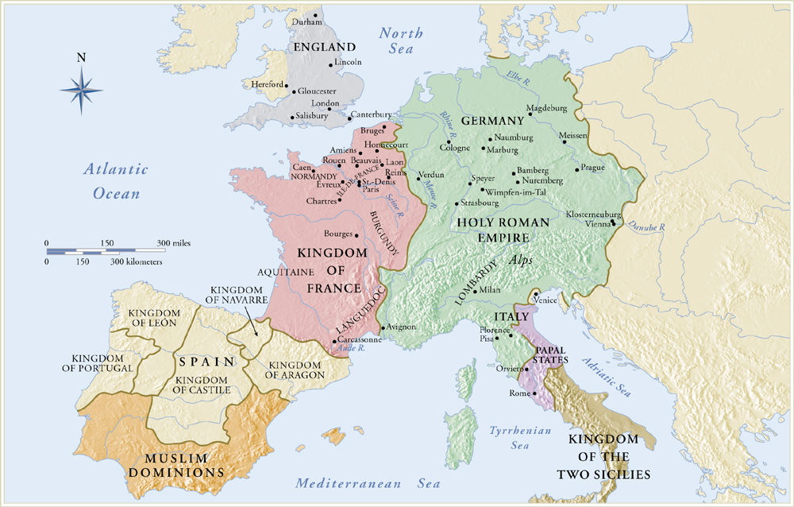
Europe About 1200

Slide 3
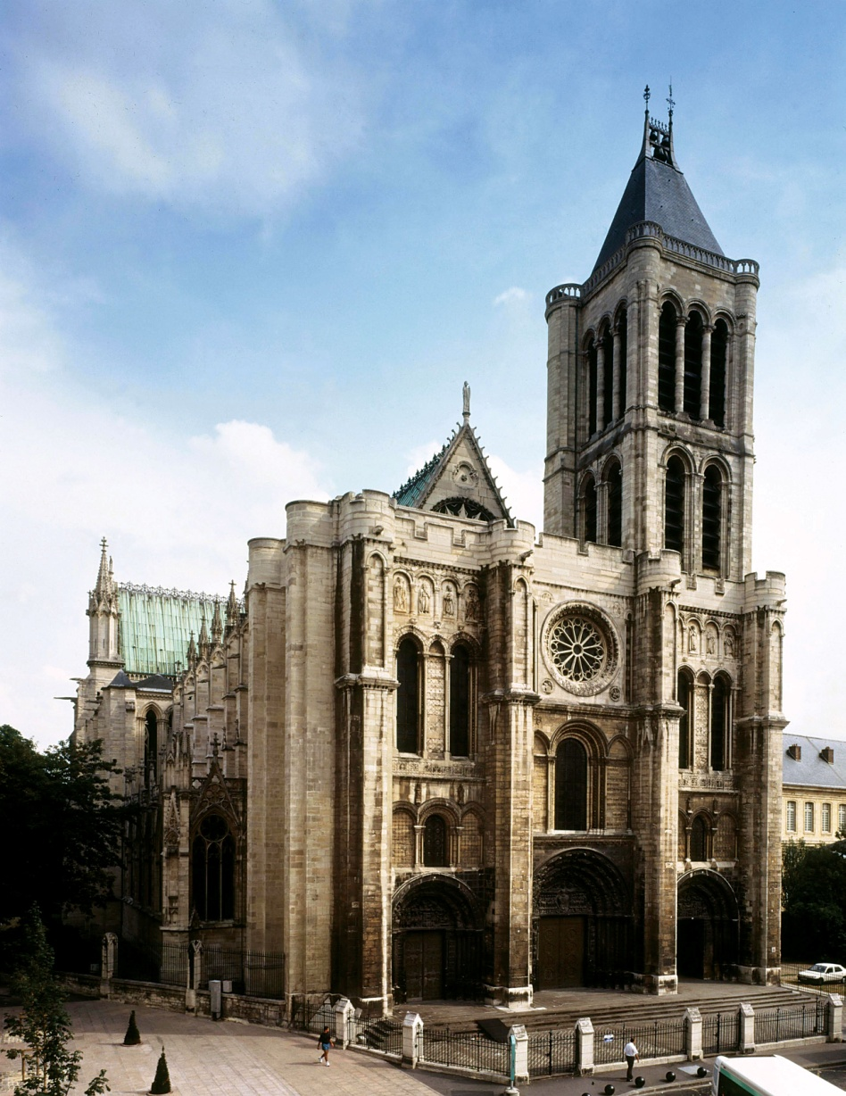
13-3A West facade of the abbey church, Saint-Denis, France, 1135–1140.

Slide 4
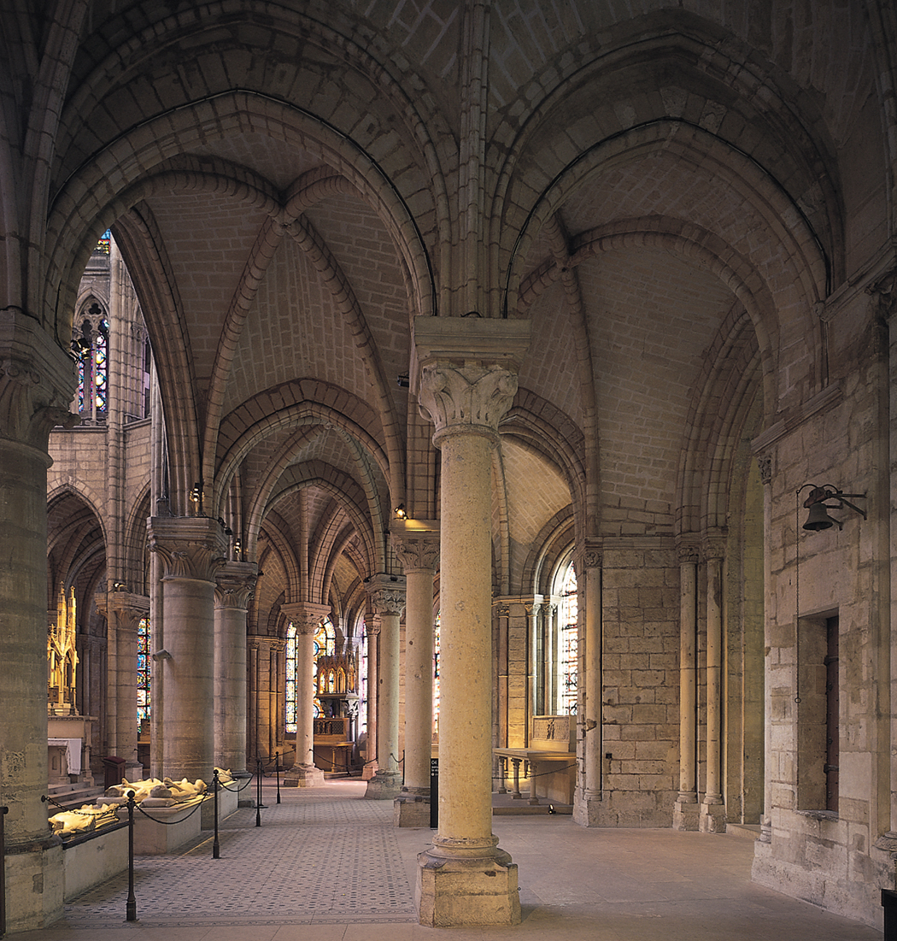
Figure 13-2 Ambulatory and radiating chapels, abbey church, Saint-Denis, France, 1140–1144.

Slide 5
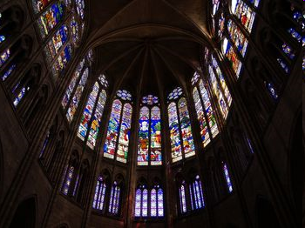
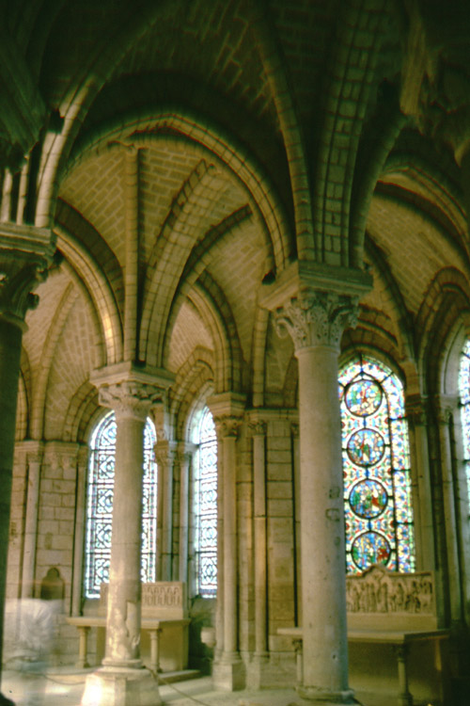
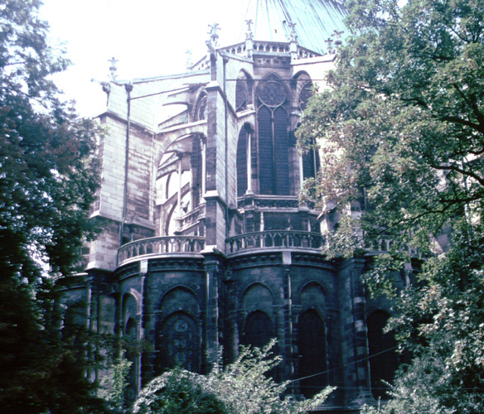
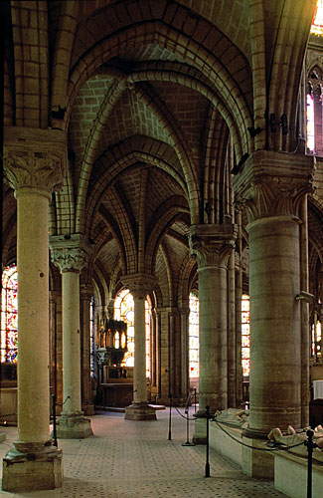
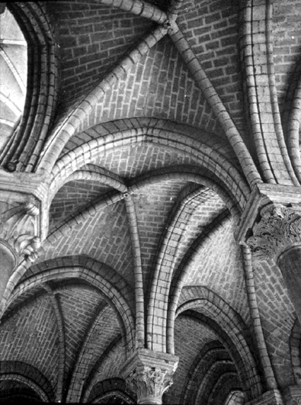
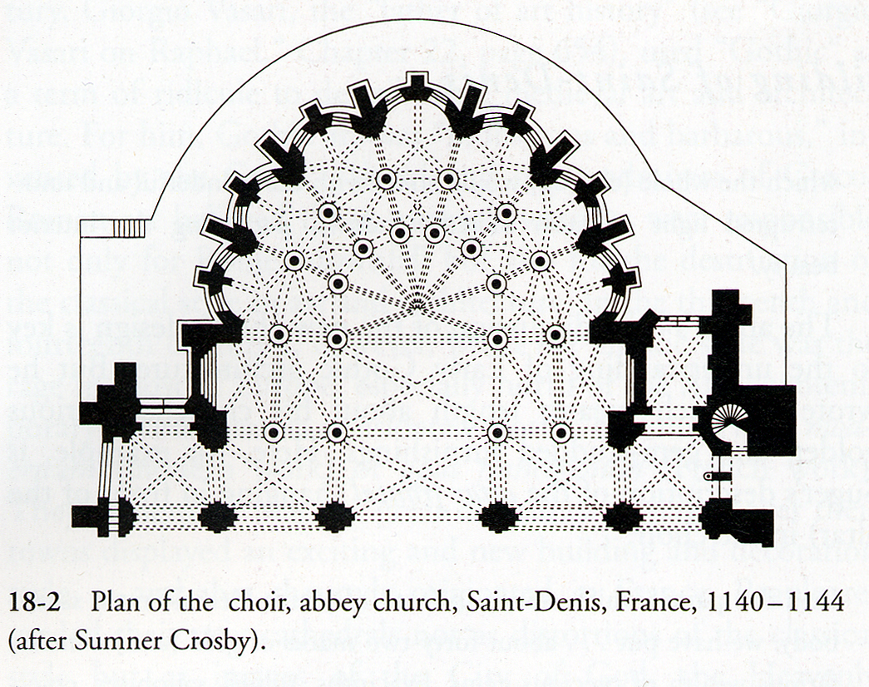
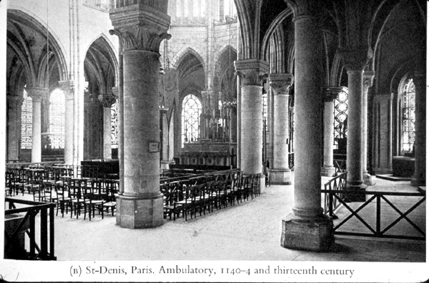
Saint-Denis, France

Slide 6
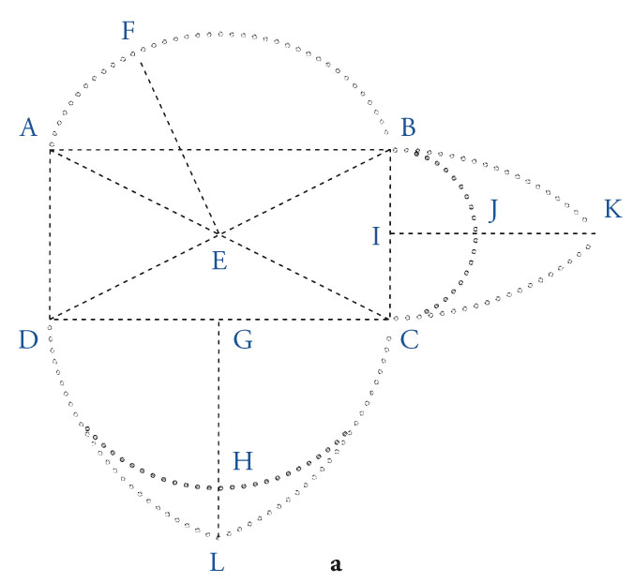
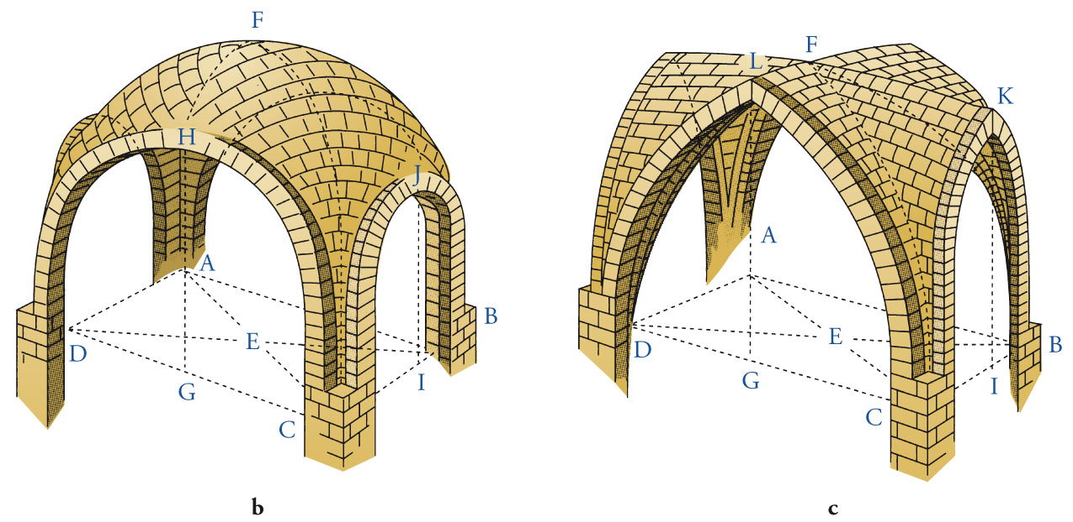
Figure 13-4 Diagram (a) and drawings of rib vaults with semicircular (b) and pointed (c) arches.

Slide 7
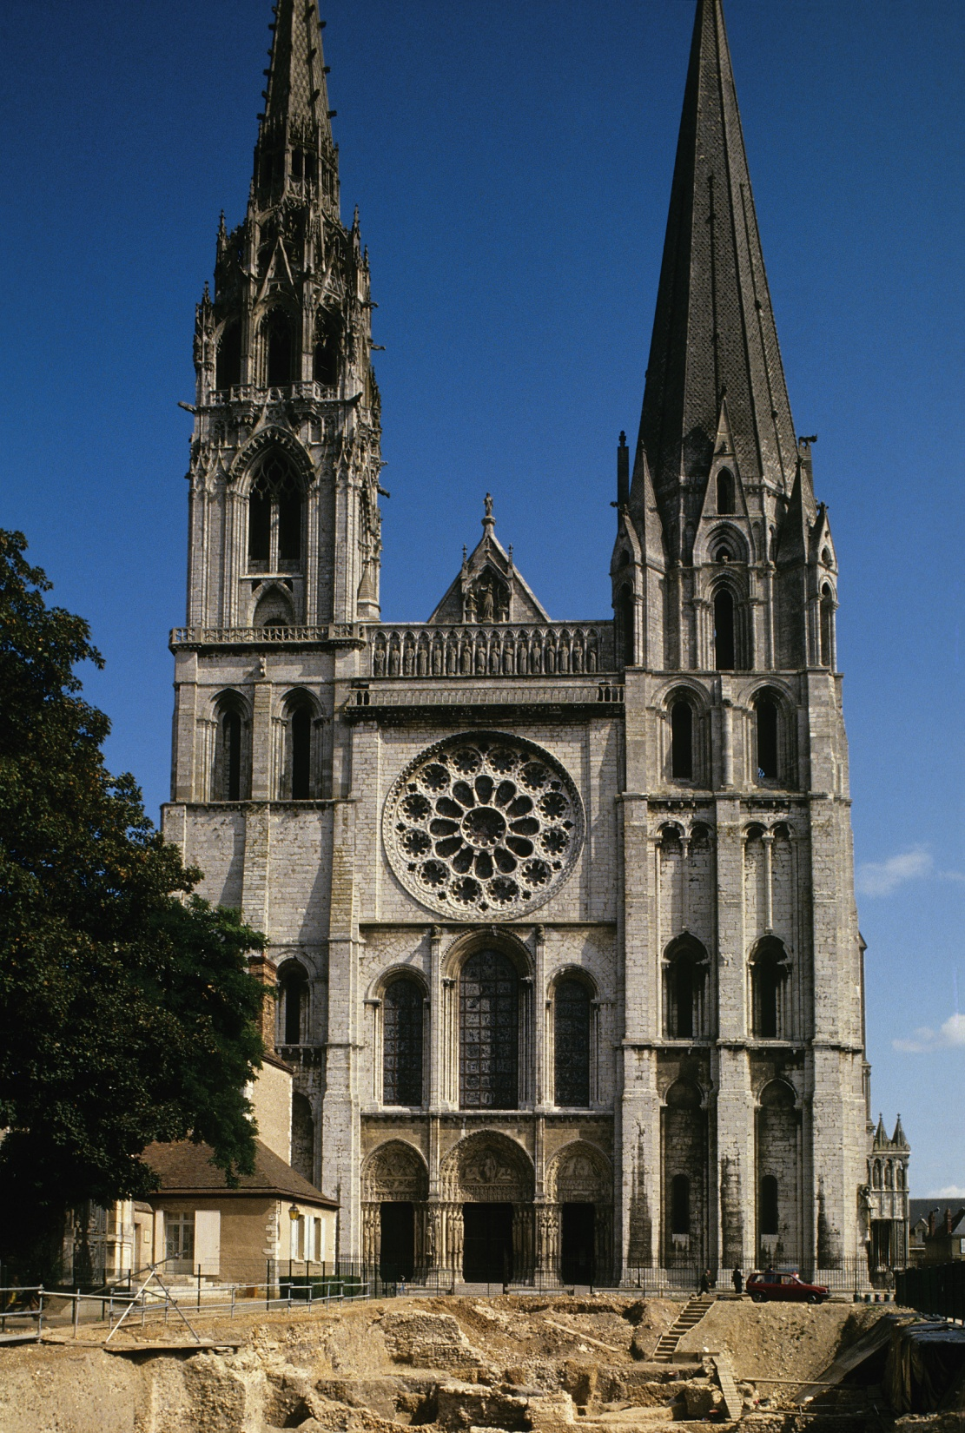
Figure 13-5 West facade, Chartres Cathedral, Chartres, France, ca. 1145-1155.

Slide 8
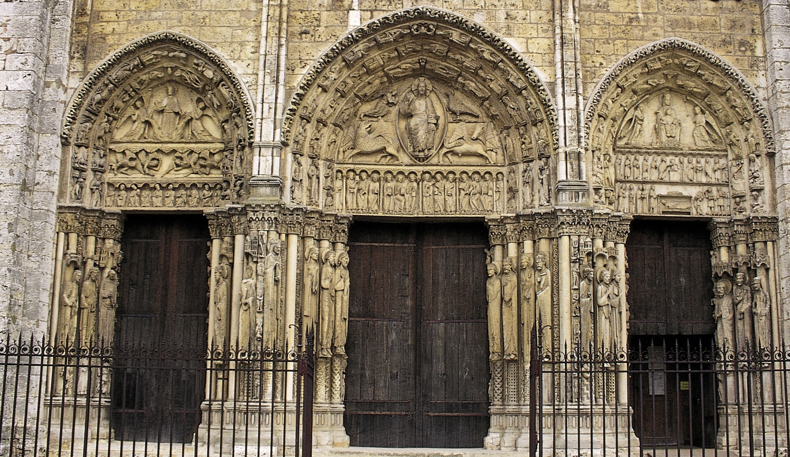
Figure 13-6 Royal Portal, west facade, Chartres Cathedral, Chartres, France, ca. 1145–1155.

Slide 9
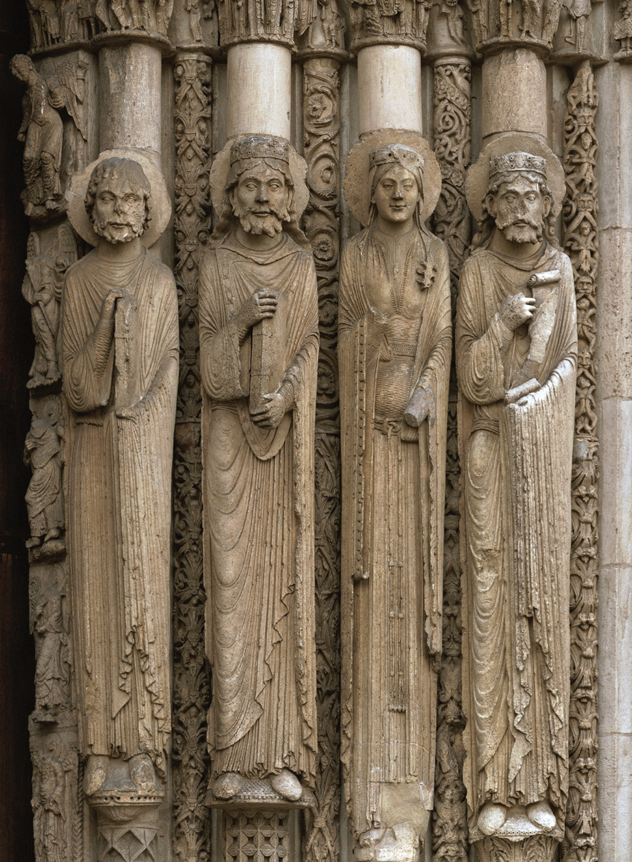
Figure 13-7 Old Testament kings and queens, jamb statues, central doorway of Royal Portal, Chartres Cathedral, Chartres, France, ca. 1145–1155.

Slide 10
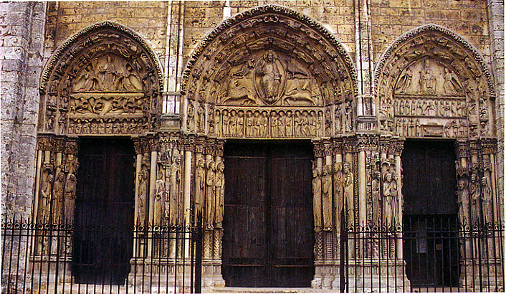
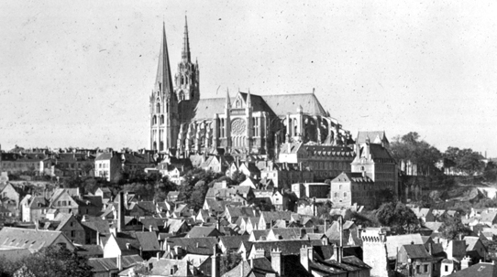
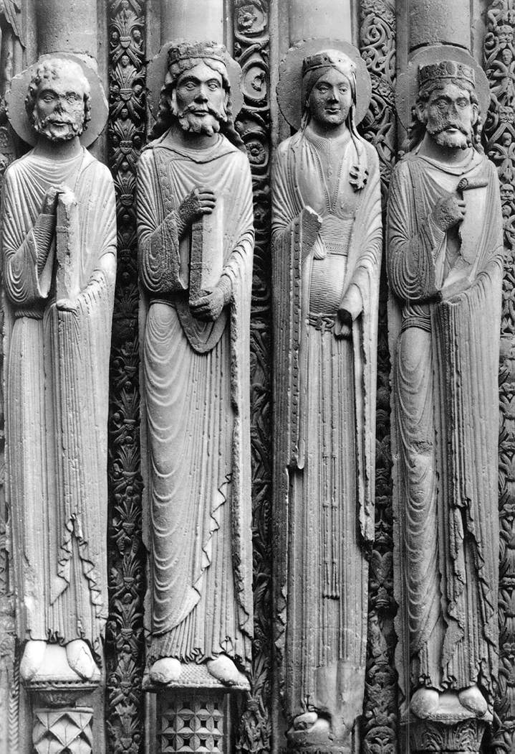
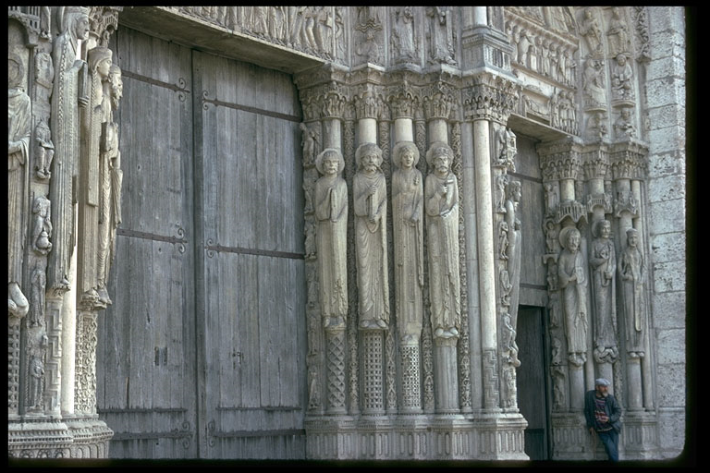
Royal Portal
Chartes Cathedral
Old Testament queen and two kings, jamb statues, central doorway
l
hanser.ceat.okstate.edu/.../2003mt16sld.htm
Gardner’s Art Through the Ages
http://www.mtholyoke.edu/acad/intdept/pnp/images/cath1-17.jpg

Slide 11
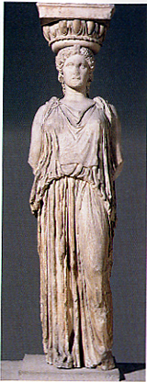
Attached, yet 3-d effect
Column itself

Slide 12
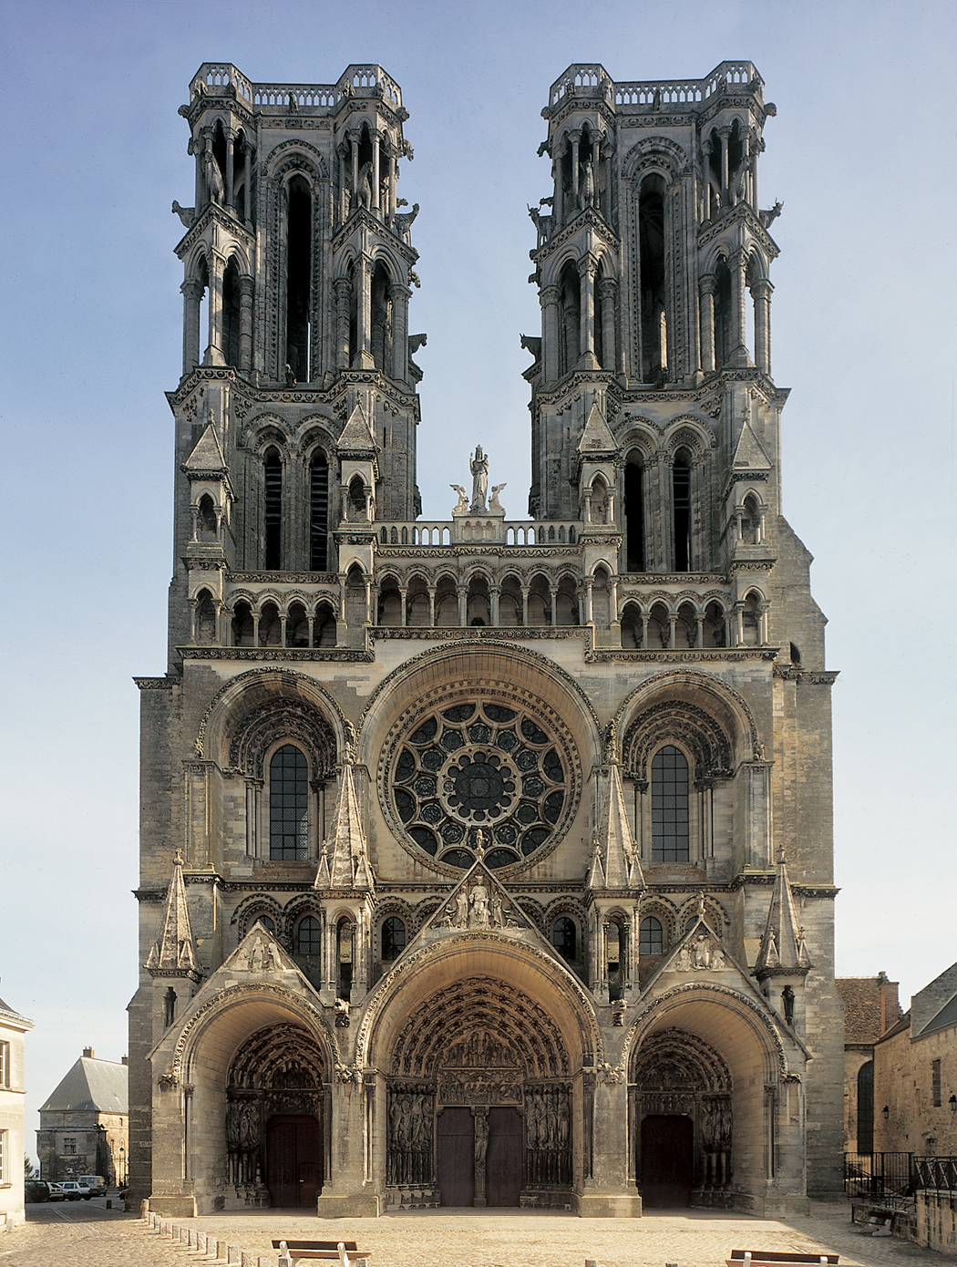
Figure 13-8 West facade of Laon Cathedral, Laon, France, begun ca. 1190.

Slide 13
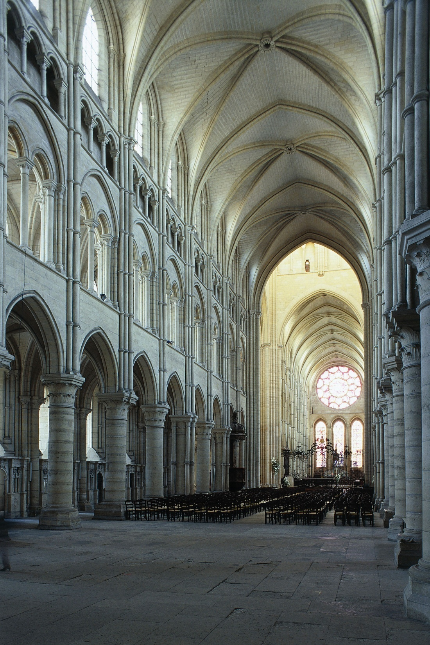
Figure 13-9 Interior of Laon Cathedral (looking northeast), Laon, France, begun ca. 1190.

Slide 14
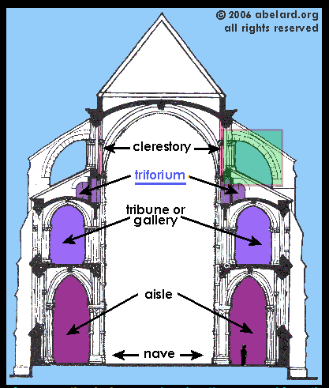

Slide 15
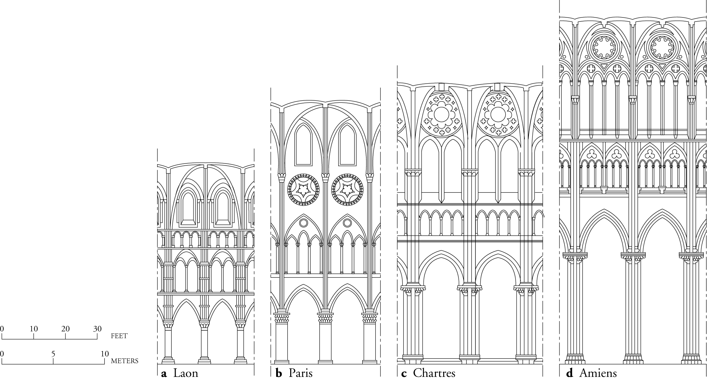
Figure 13-10 Nave elevations of four French Gothic cathedrals at the same scale (after Louis Grodecki).

Slide 16
Early Gothic
High Gothic
Lancets
Lancets
Clerestory
Triforium
Vaulted Gallery
Nave Arcade
Two sets
of windows –
Stained glass oculi replaces triforium
One set
of windows

Slide 17
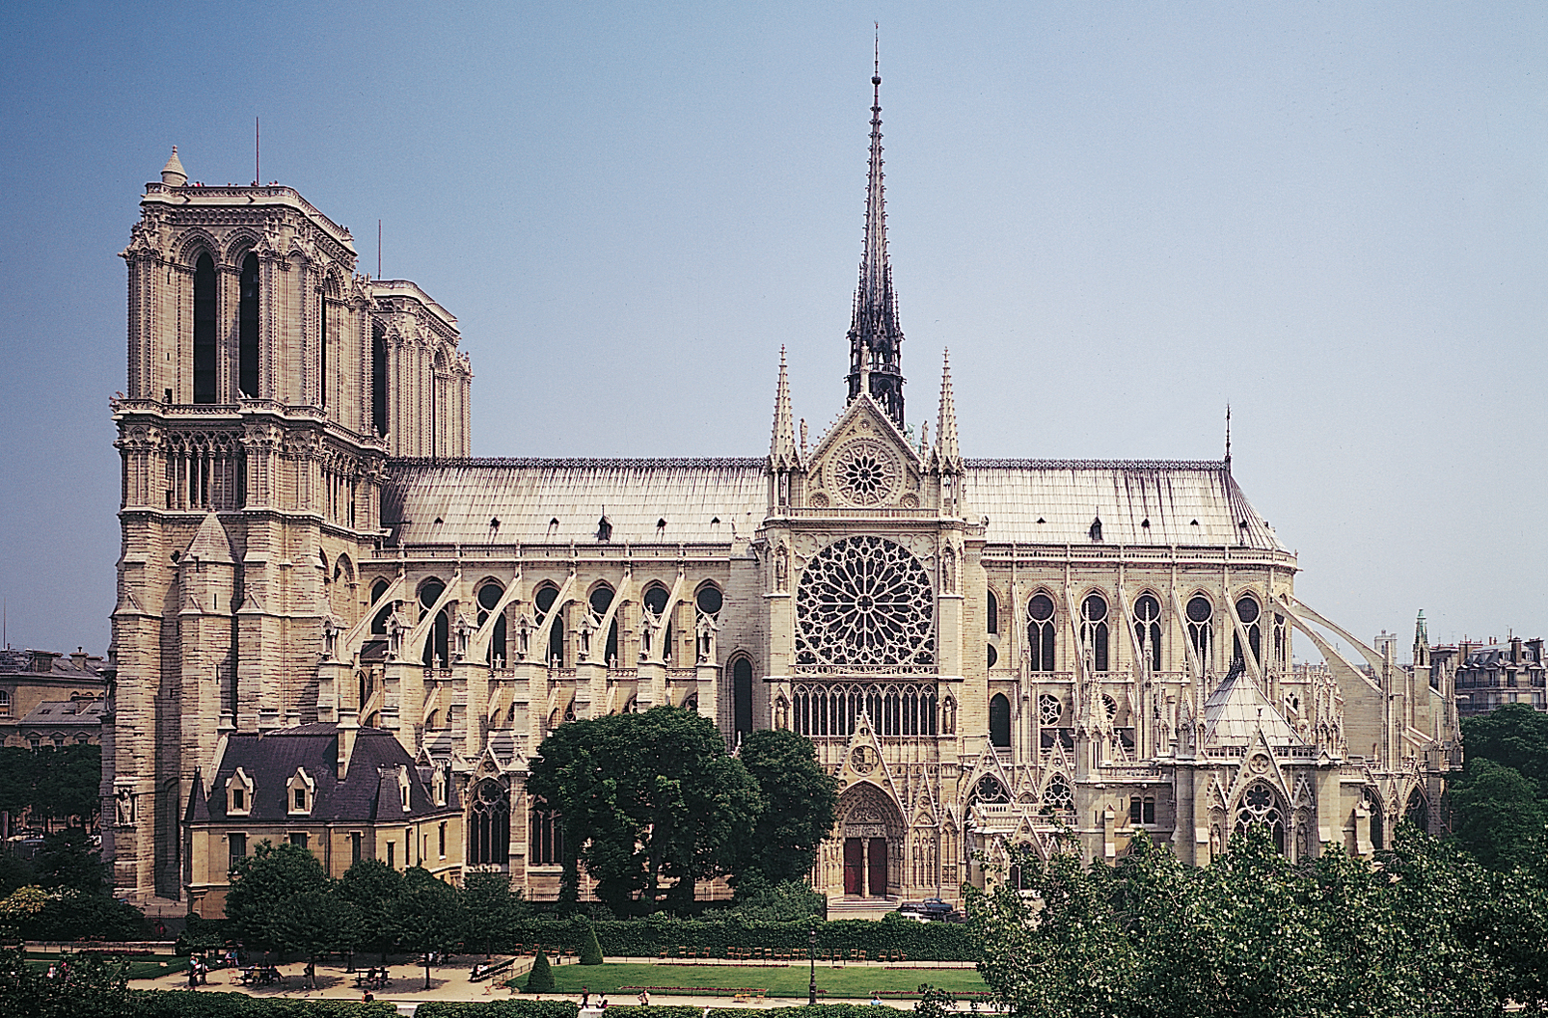
Figure 13-11 Notre-Dame (looking north), Paris, France, begun 1163; nave and flying buttresses, ca. 1180–1200; remodeled after 1225. 1

Slide 18
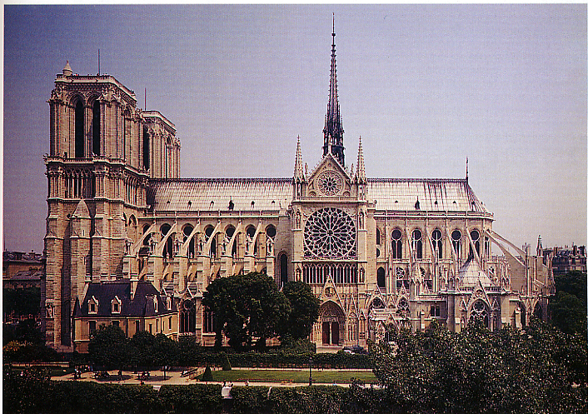
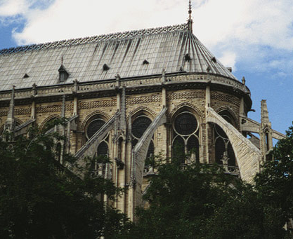
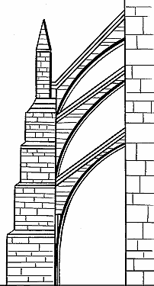
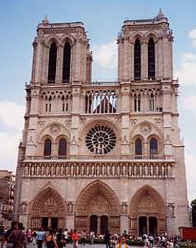
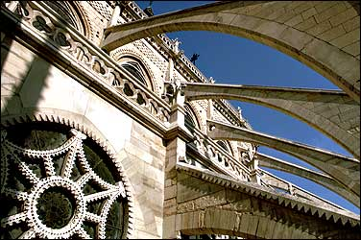
Notre-Dame, Paris

Slide 19
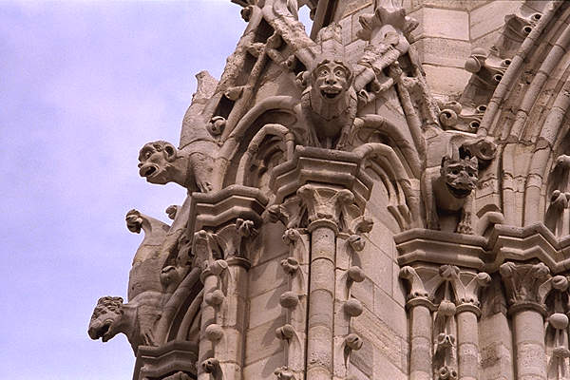
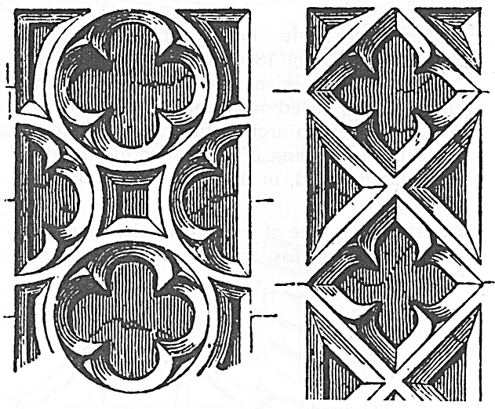
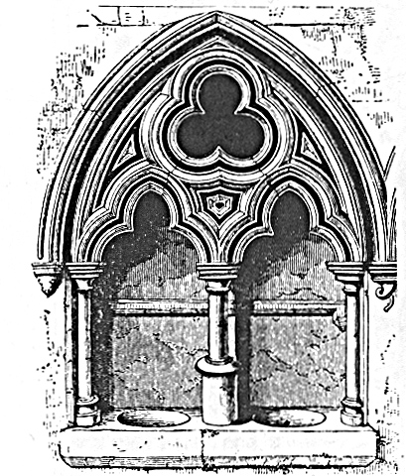
Quatrefoils Trefoils Gargoyles Notre Dame, Paris & Trefoil Arches (rain gutters)
Notre Dame, Paris

Slide 20
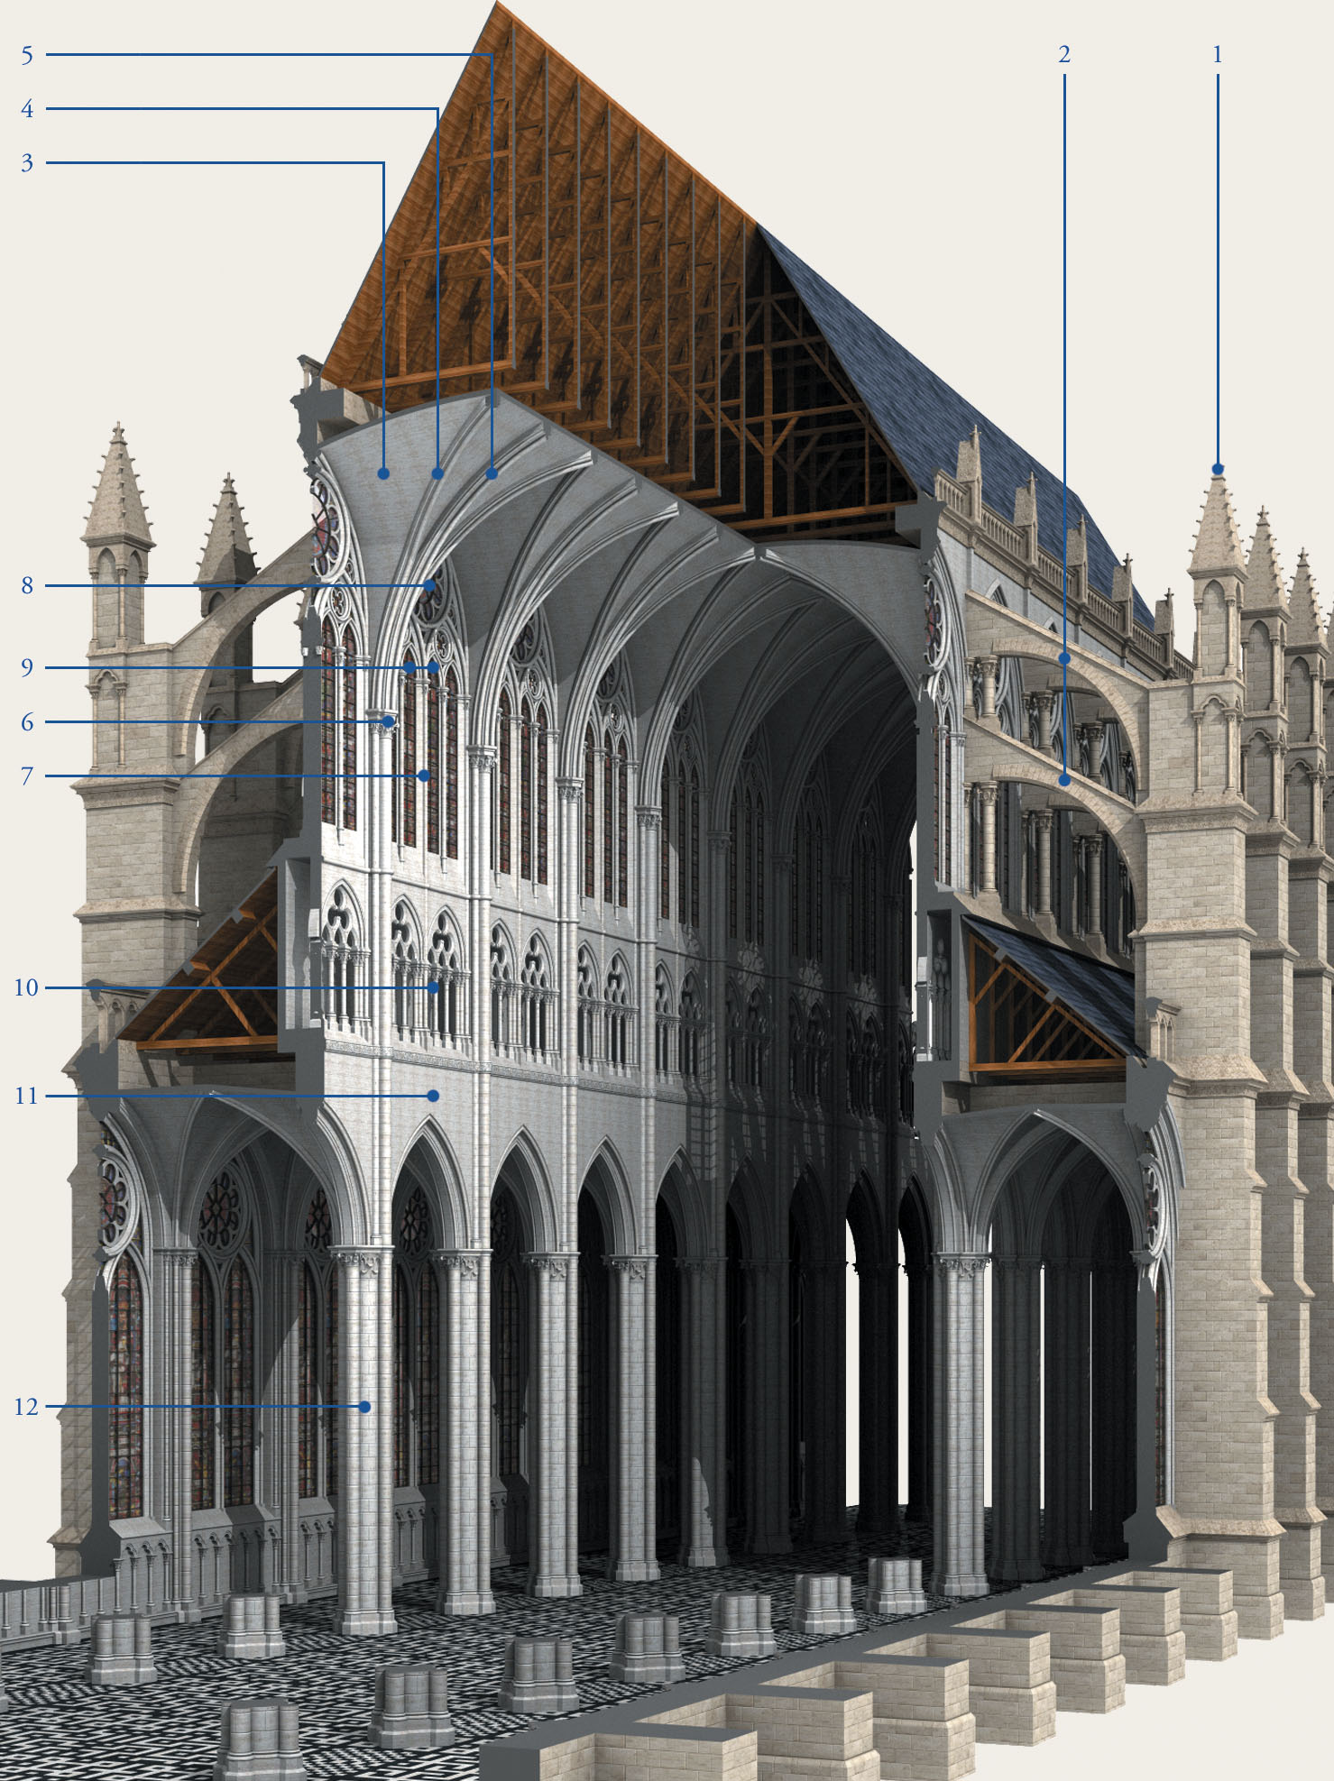
Figure 13-12 Cutaway view of a typical French Gothic cathedral (John Burge). (1) pinnacle, (2) flying buttress, (3) vaulting web, (4) diagonal ribs, (5) transverse rib, (6) springing, (7) clerestory, (8) oculus, (9) lancet, (10) triforium, (11) nave arcade, (12) compound pier with responds.

Slide 21
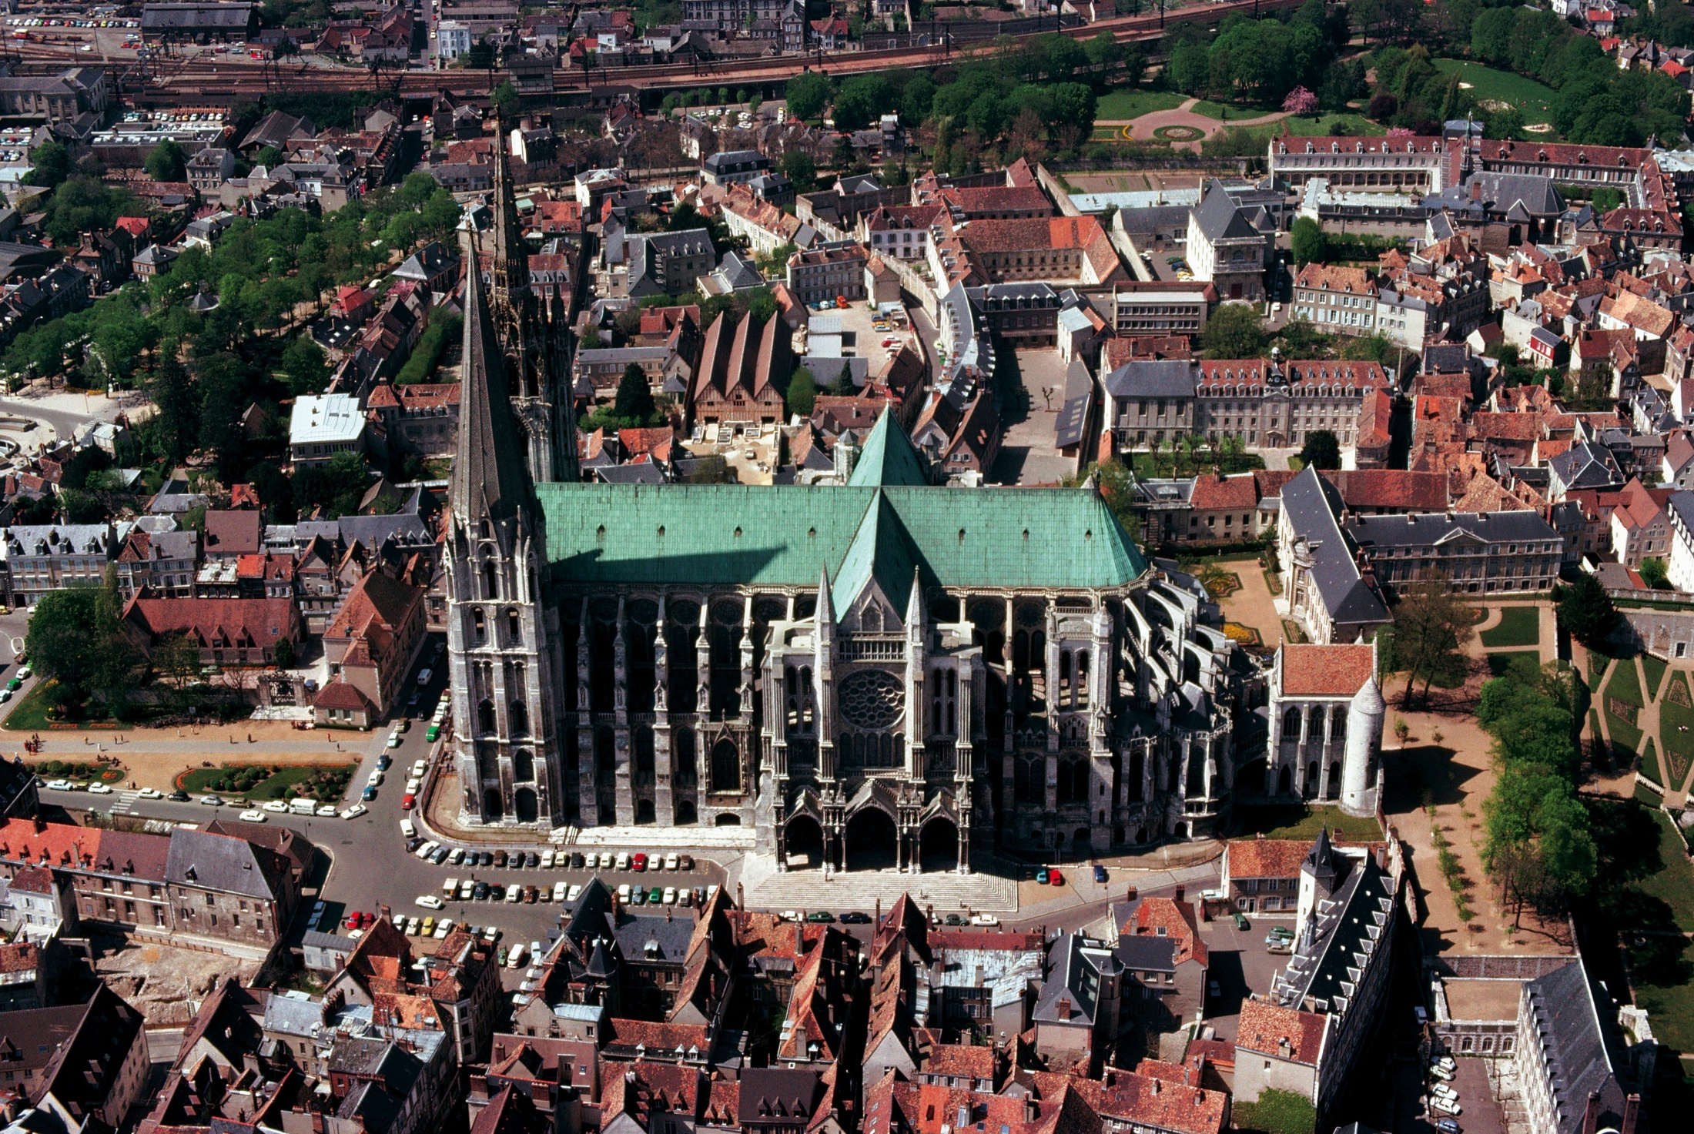
Figure 13-1 Aerial view of Chartres Cathedral (looking north), Chartres, France, as rebuilt after 1194.

Slide 22
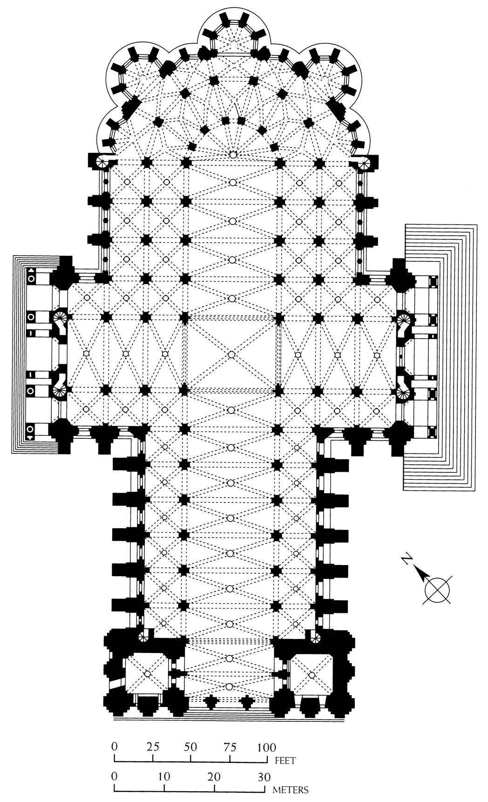
Figure 13-13 Plan of Chartres Cathedral, Chartres, France, as rebuilt after 1194 (after Paul Frankl).

Slide 23
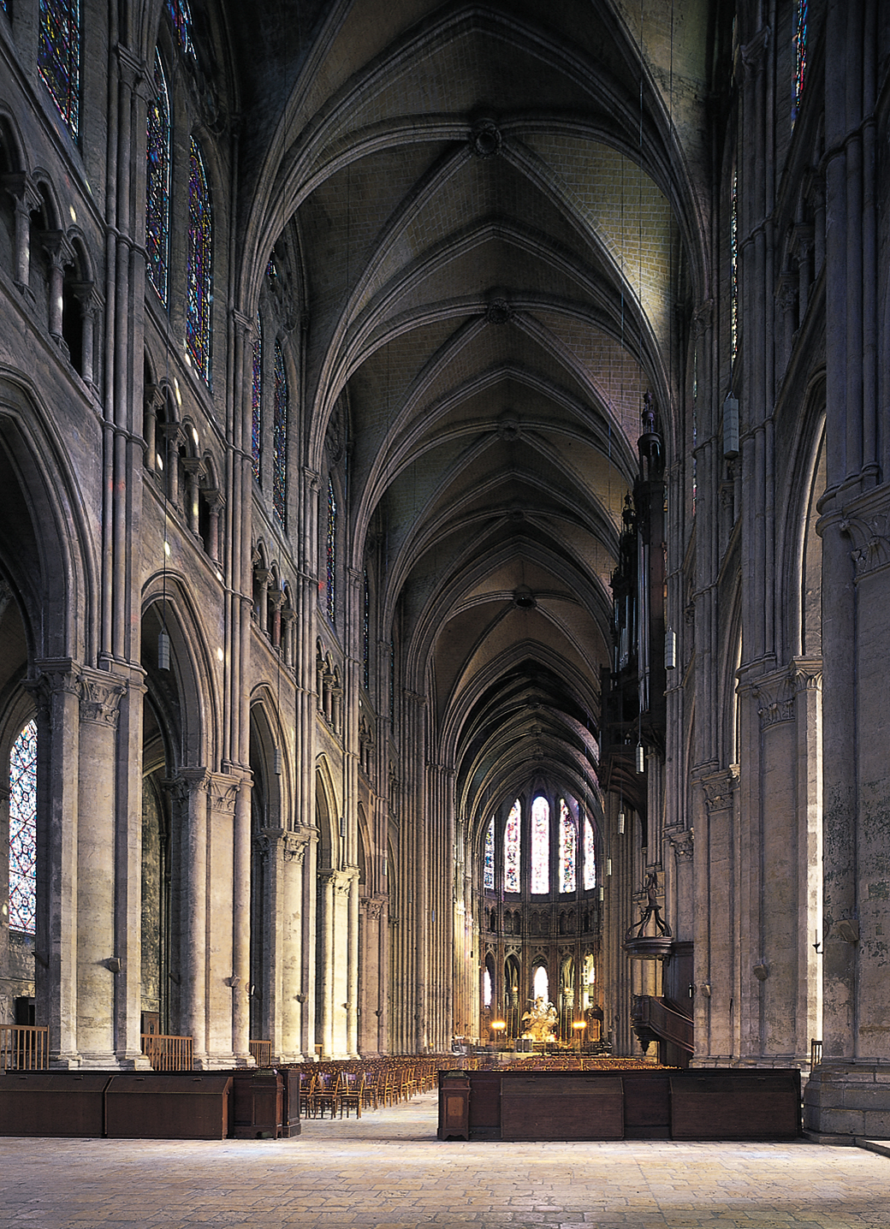
Figure 13-14 Interior of Chartres Cathedral (looking east), Chartres, France, begun 1194.
© 2005 Saskia Cultural Documentation, Ltd.

Slide 24
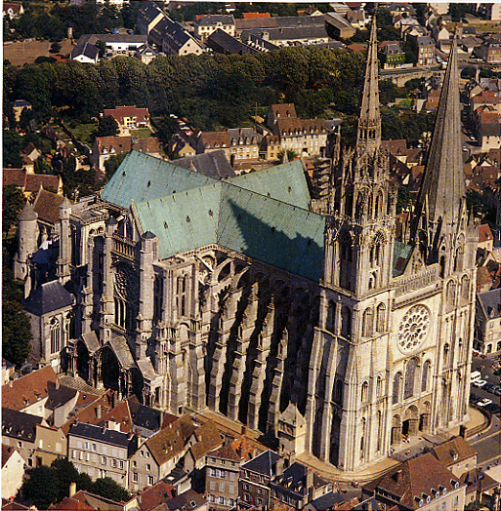
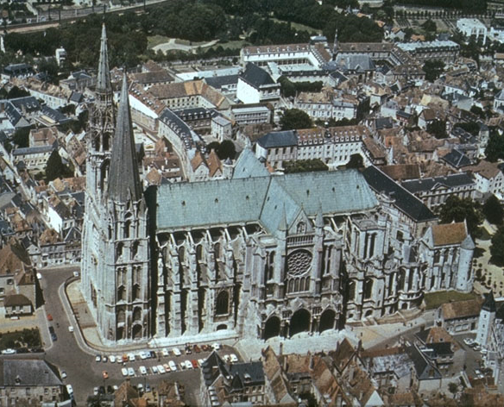
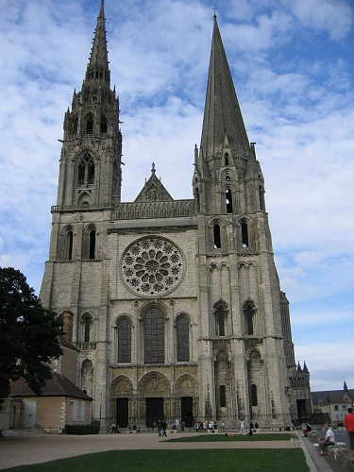
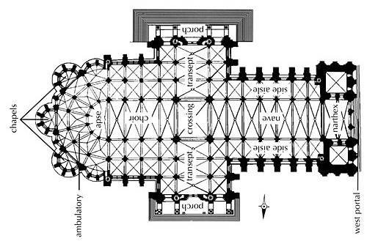
Chartres
Cathedral

Slide 25
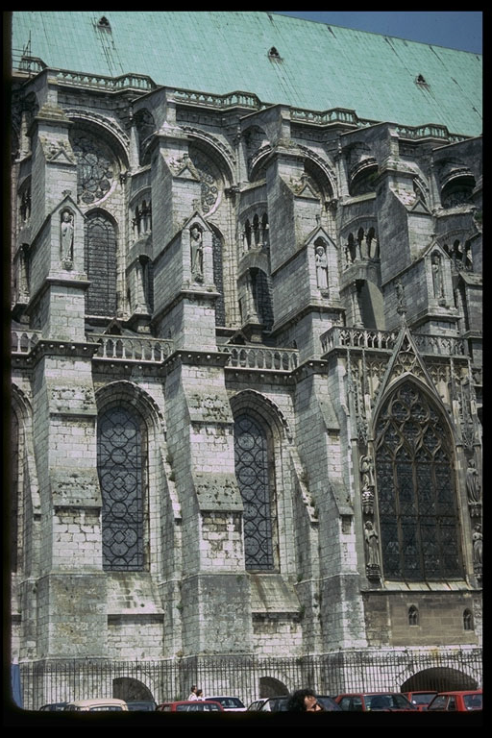
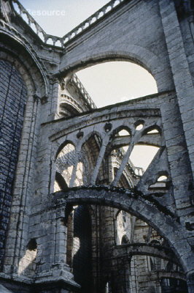
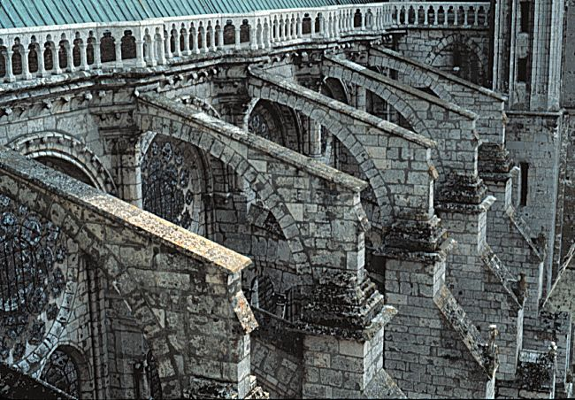
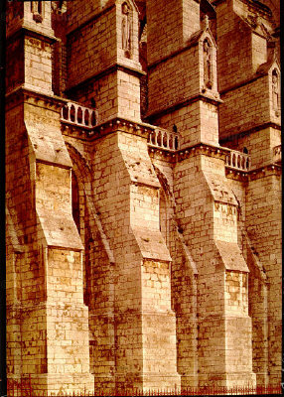
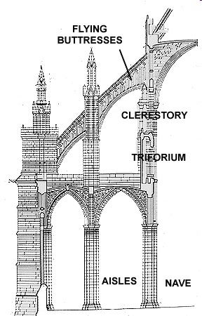
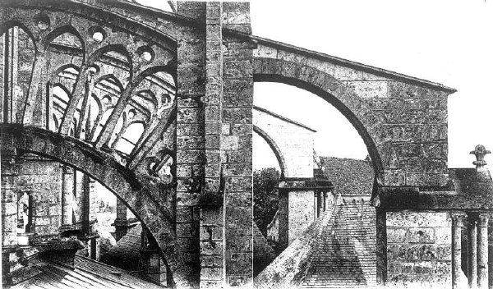
FLYING BUTTRESSES
Chartres Cathedral

Slide 26
13-15 Stonemasons and sculptors, detail of a stained-glass window in the northernmost radiating chapel in the ambulatory, Chartres Cathedral, Chartres, France, ca. 1200-1220

Slide 27
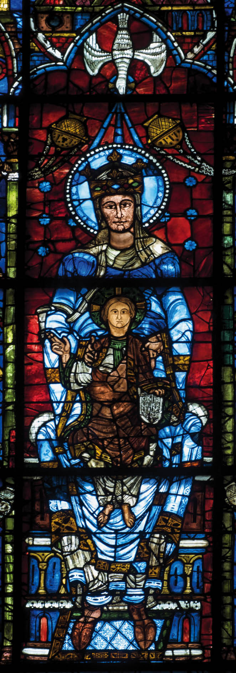
Figure 13-16 Virgin and Child and angels (Notre Dame de la Belle Verrière), detail of a window in the choir of Chartres Cathedral, Chartres, France, ca. 1170, with 13th century side panels. Stained glass, full height 16’.

Slide 28
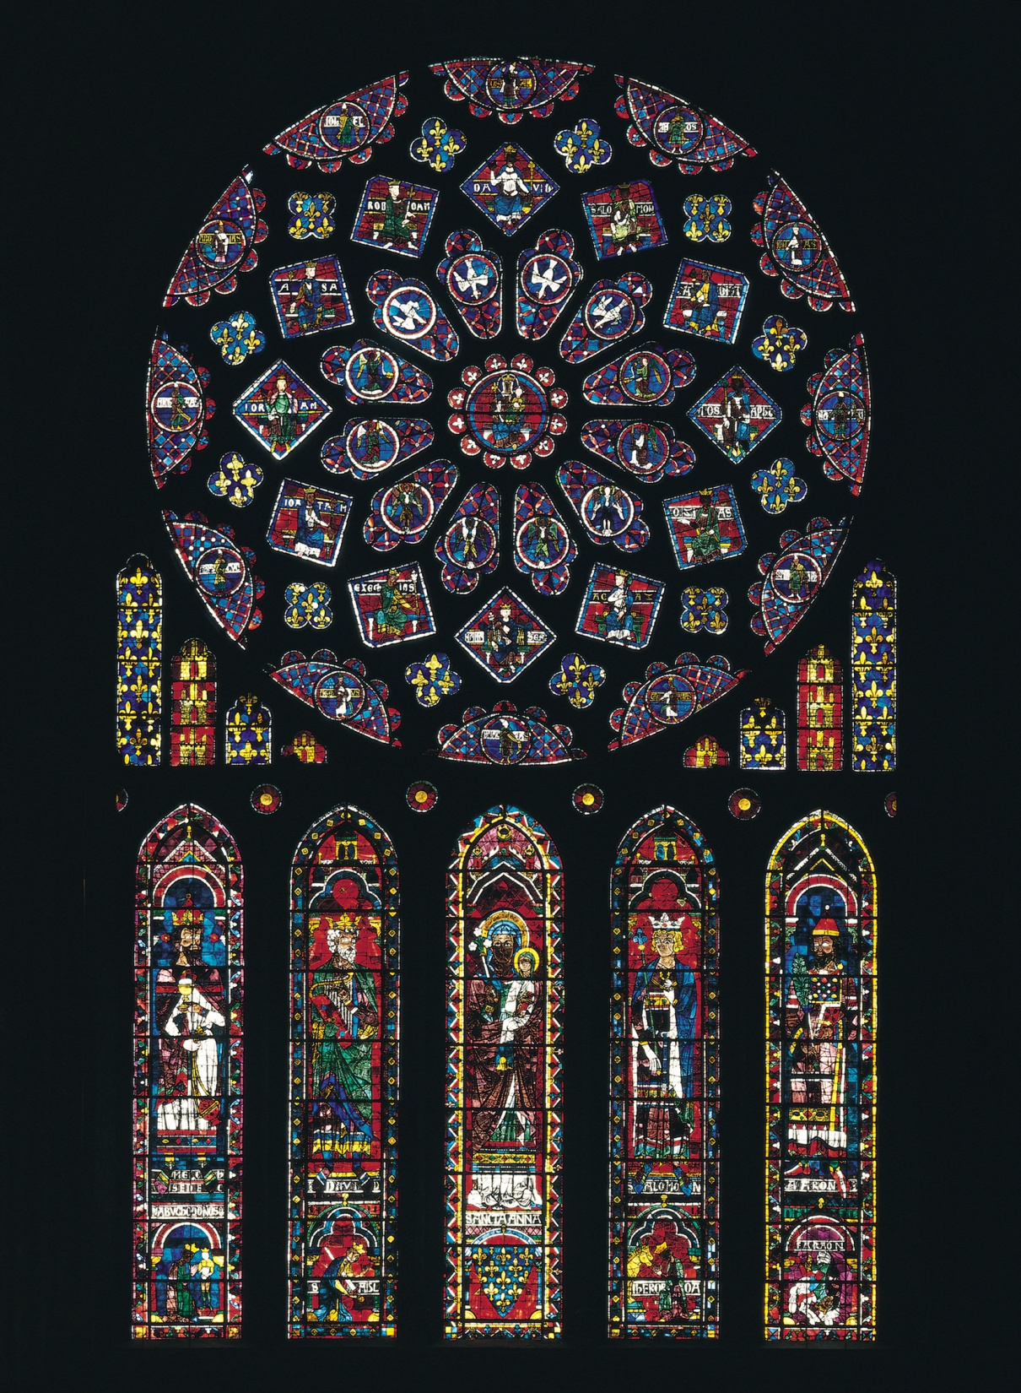
Figure 13-17 Rose window and lancets, north transept, Chartres Cathedral, Chartres, France, ca. 1220. Stained glass, rose window 43’ in diameter.

Slide 29
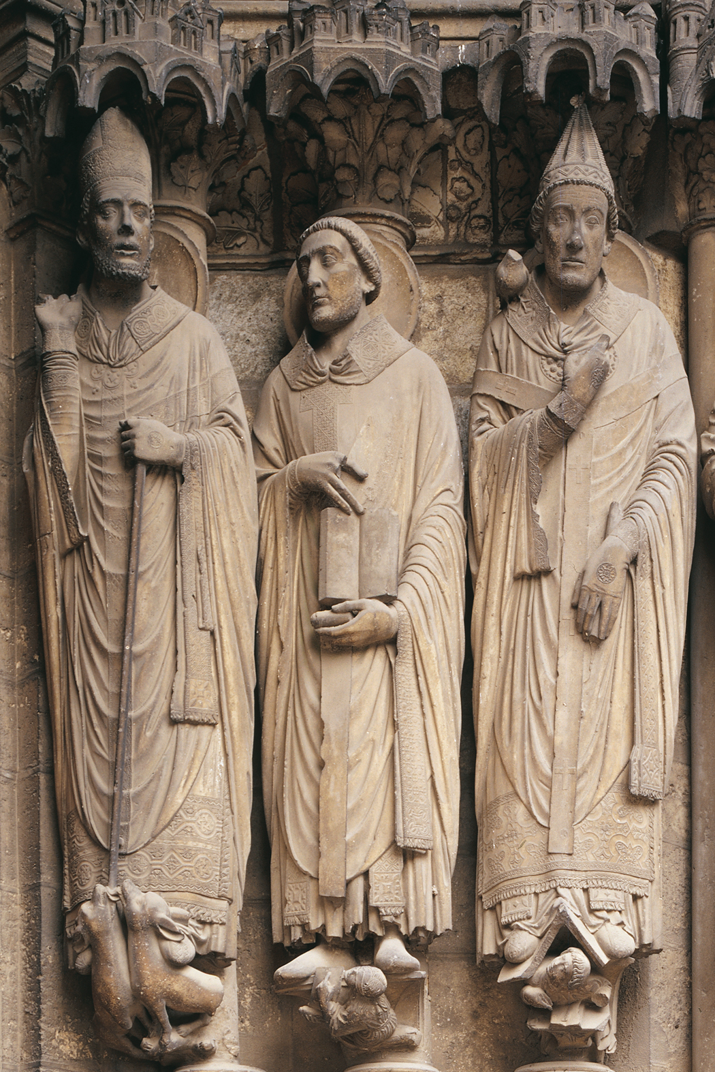
Figure 13-18A Saints Martin, Jerome, and Gregory, jamb statues, Porch of the Confessors (right doorway), south transept, Chartres Cathedral, Chartres, France, ca. 1220–1230.

Slide 30
Figure 13-18 Saint Theodore, jamb statue, Porch of the Martyrs (left doorway), south transept, Chartres Cathedral, Chartres, France, ca. 1230.

Slide 31
Figure 13-20 ROBERT DE LUZARCHES, THOMAS DE CORMONT, and RENAUD DE CORMONT, interior of Amiens Cathedral (looking east), Amiens, France, begun 1220.

Slide 32
Figure 13-21 ROBERT DE LUZARCHES, THOMAS DE CORMONT, AND RENAUD DE CORMONT, vaults, clerestory, and triforium of the choir of Amiens Cathedral, Amiens, France, begun 1220.

Slide 33
Amiens Cathedral

Slide 34
Figure 13-19 ROBERT DE LUZARCHES, THOMAS DE CORMONT, and RENAUD DE CORMONT, west facade of Amiens Cathedral, Amiens, France, begun 1220.

Slide 36
Figure 13-22 Christ (Beau Dieu), trumeau statue of central doorway, west facade, Amiens Cathedral, Amiens, France, ca. 1220–1235.

Slide 37
Figure 13-23 West facade of Reims Cathedral, Reims, France, ca. 1225–1290.

Slide 38
13-23A Nave (looking west) of Reims Cathedral, Reims, France, begun 1211; west end ca. 1260–1290.

Slide 39
Reims Cathedral

Slide 40
Figure 13-24 Annunciation and Visitation, jamb statues of central doorway, west facade, Reims Cathedral, Reims, France, ca. 1230-1255

Slide 41
Figure 13-25 Interior of the upper chapel, Sainte-Chapelle, Paris, France, 1243–1248.

Slide 42
Sainte-Chapelle, Paris

Slide 43
Figure 13-26 Virgin and Child (Virgin of Paris), Notre-Dame, Paris, France, early fourteenth century.

Slide 44
Figure 13-27 West facade of Saint-Maclou, Rouen, France, ca. 1500–1514.

Slide 45
Figure 13-28 Aerial view of the fortified town of Carcassonne, France. Bastions and towers, 12th–13th centuries, restored by EUGÈNE VIOLLET-LE-DUC in the 19th century.

Slide 46
Figure 13-29 Hall of the cloth guild, Bruges, Belgium, begun 1230.

Slide 47
Figure 13-31 VILLARD DE HONNECOURT, figures based on geometric shapes, folio 18 verso of a sketchbook, from Paris, France, ca. 1220-1235. Ink on vellum, 9 ¼” X 6”. Bibiliotheque Nationale, Paris.

Slide 48
Figure 13-32 God as architect of the world, folio 1 verso of a moralized Bible, from Paris, France, ca. 1220-1230. Ink, tempera, and gold leaf on vellum, 1’ 1 ½” X 8 ¼”. Osterreichische Nationalbibliothek, Vienna.

Slide 49
Figure 13-33 Blanche of Castile, Louis IX, and two monks, dedication page (folio 8 recto) of a moralized Bible, from Paris, France, 1226–1234. Ink, tempera, and gold leaf on vellum, 1’ 3” X 10 1/2”. Pierpont Morgan Library, New York.

Slide 50
Figure 13-34 Abraham and the three angels, folio 7 verso of the Psalter of Saint Louis, from Paris, France, 1253–1270. Ink, tempera, and gold leaf on vellum, 5” X 3 1/2”. Bibliothèque Nationale, Paris.

Slide 51
Figure 13-35 MASTER HONORÉ, David anointed by Samuel and battle of David and Goliath, folio 7 verso of the Breviary of Philippe le Bel, from Paris, France, 1296. Ink and tempera on vellum, 7 7/8” X 4 7/8”. Bibliothèque Nationale, Paris.

Slide 52
Figure 13-36 JEAN PUCELLE, David before Saul, folio 24 verso of the Belleville Breviary, from Paris, France, ca. 1325. Ink and tempera on vellum, 9 1/2” X 6 3/4”. Bibliothèque Nationale, Paris.

Slide 53
13-36A JEAN PUCELLE, Betrayal of Christ and Annunciation, folios 15 verso and 16 recto of the Hours of Jeanne d’Evreux, from Paris, France, ca. 1325–1328. Ink and tempera on vellum, each page 3 1/2" X 2 1/2". Metropolitan Museum of Art, New York (Cloisters Collection).

Slide 54
Figure 13-37 Virgin of Jeanne d’Evreux, from the abbey church of Saint-Denis, France, 1339. Silver gilt and enamel, 2’ 3 1/2” high. Louvre, Paris.

Slide 55
13-38 The Castle of Love and knights jousting, lid of a jewelry casket, from Paris, France, ca. 1330-1350. Ivory and iron, 4 ½” X 9 ¾”. Walters Art Museum, Baltimore.

Slide 56
Figure 13-39 Aerial view of Salisbury Cathedral, Salisbury, England, 1220–1258; west facade completed 1265; spire ca. 1320–1330.

Slide 57
Figure 13-40 Plan of Salisbury Cathedral, Salisbury, England, 1220–1258.

Slide 58
Figure 13-41 Interior of Salisbury Cathedral (looking east), Salisbury, England, 1220–1258.

Slide 59
Salisbury Cathedral – English Gothic
Amiens
Salisbury

Slide 60
Salisbury crossing tower
dominates silhouette
Amiens crossing tower –
small

Slide 61
Salisbury – English Gothic Amiens – French Gothic
English –
pier colonnettes
stop at springing
of nave arches
Vault ribs rise
from corbel in
triforium
Verticality vs.
horizontality
http://www.mtholyoke.edu/acad/intdept/pnp/images/cath1-64.jpg

Slide 62
Figure 13-42 Choir of Gloucester Cathedral (looking east), Gloucester, England, 1332–1357.

Slide 63
Figure 13-43 ROBERT and WILLIAM VERTUE, fan vaults of the chapel of Henry VII, Westminster Abbey, London, England, 1503–1519.

Slide 64
Figure 13-44 NICHOLAS OF VERDUN, sacrifice of Isaac, detail of the Klosterneuburg Altar, from the abbey church at Klosterneuburg, Austria, 1181. Gilded copper and enamel, 5 1/2” high. Stiftsmuseum, Klosterneuburg.

Slide 65
Figure 13-45 NICHOLAS OF VERDUN, Shrine of the Three Kings, from Cologne Cathedral, Cologne, Germany, begun ca. 1190. Silver, bronze, enamel, and gemstones, 5’ 8” X 6’ X 3’ 8”. Cathedral Treasury, Cologne.

Slide 66
Figure 13-46 Death of the Virgin, tympanum of left doorway, south transept, Strasbourg Cathedral, Strasbourg, France, ca. 1230.

Slide 67
13-47 NAUMBURG MASTER, Crucifixion, west choir screen of Naumburg Cathedral, Naumburg, Germany, ca. 1249–1255.

Slide 68
Figure 13-48 NAUMBURG MASTER, Ekkehard and Uta, statues in the west choir, Naumburg Cathedral, Naumburg, Germany, ca. 1249–1255. Painted limestone, Ekkehard 6’ 2” high.

Slide 69
Figure 13-49 Equestrian portrait (Bamberg Rider), statue in the east choir, Bamberg Cathedral, Germany, ca. 1235–1240. Sandstone, 7’ 9” high.

Slide 70
Figure 13-50 Virgin with the Dead Christ (Röttgen Pietà), from the Rhineland, Germany, ca. 1300–1325. Painted wood, 2’ 10 1/2” high. Rheinisches Landemuseum, Bonn.

Slide 71
Figure 13-51 GERHARD OF COLOGNE, aerial view of Cologne Cathedral (looking northwest), Cologne, Germany, begun 1248; nave, facade, and towers completed 1880.

Slide 72
Figure 13-52 GERHARD OF COLOGNE, interior of Cologne Cathedral (looking east), Cologne, Germany, choir completed 1322.12

Slide 73
Cologne Cathedral
After the bombing - WWII

Slide 74
Figure 13-53 Interior of Saint Elizabeth (looking west), Marburg, Germany, 1235–1283.

Slide 75
13-54 PETER PARLER, choir (looking east) of Heiligkreuzkirche (Church of the Holy Cross), Schwäbisch Gmünd, Germany, begun 1351.

